Slide 1
Unlocking the GPU’s Full Potential: Asynchrony and CUDA Streams
Notes:
In the previous section, we covered essential concepts like execution and memory spaces, vocabulary data types, and parallel algorithms.
We also created a functional 2D heat equation simulator.
Although it currently runs on the GPU, our simulator still isn’t making full use of the system’s capabilities.
In this section, we’ll explore a few additional techniques to optimize its performance.

Slide 2
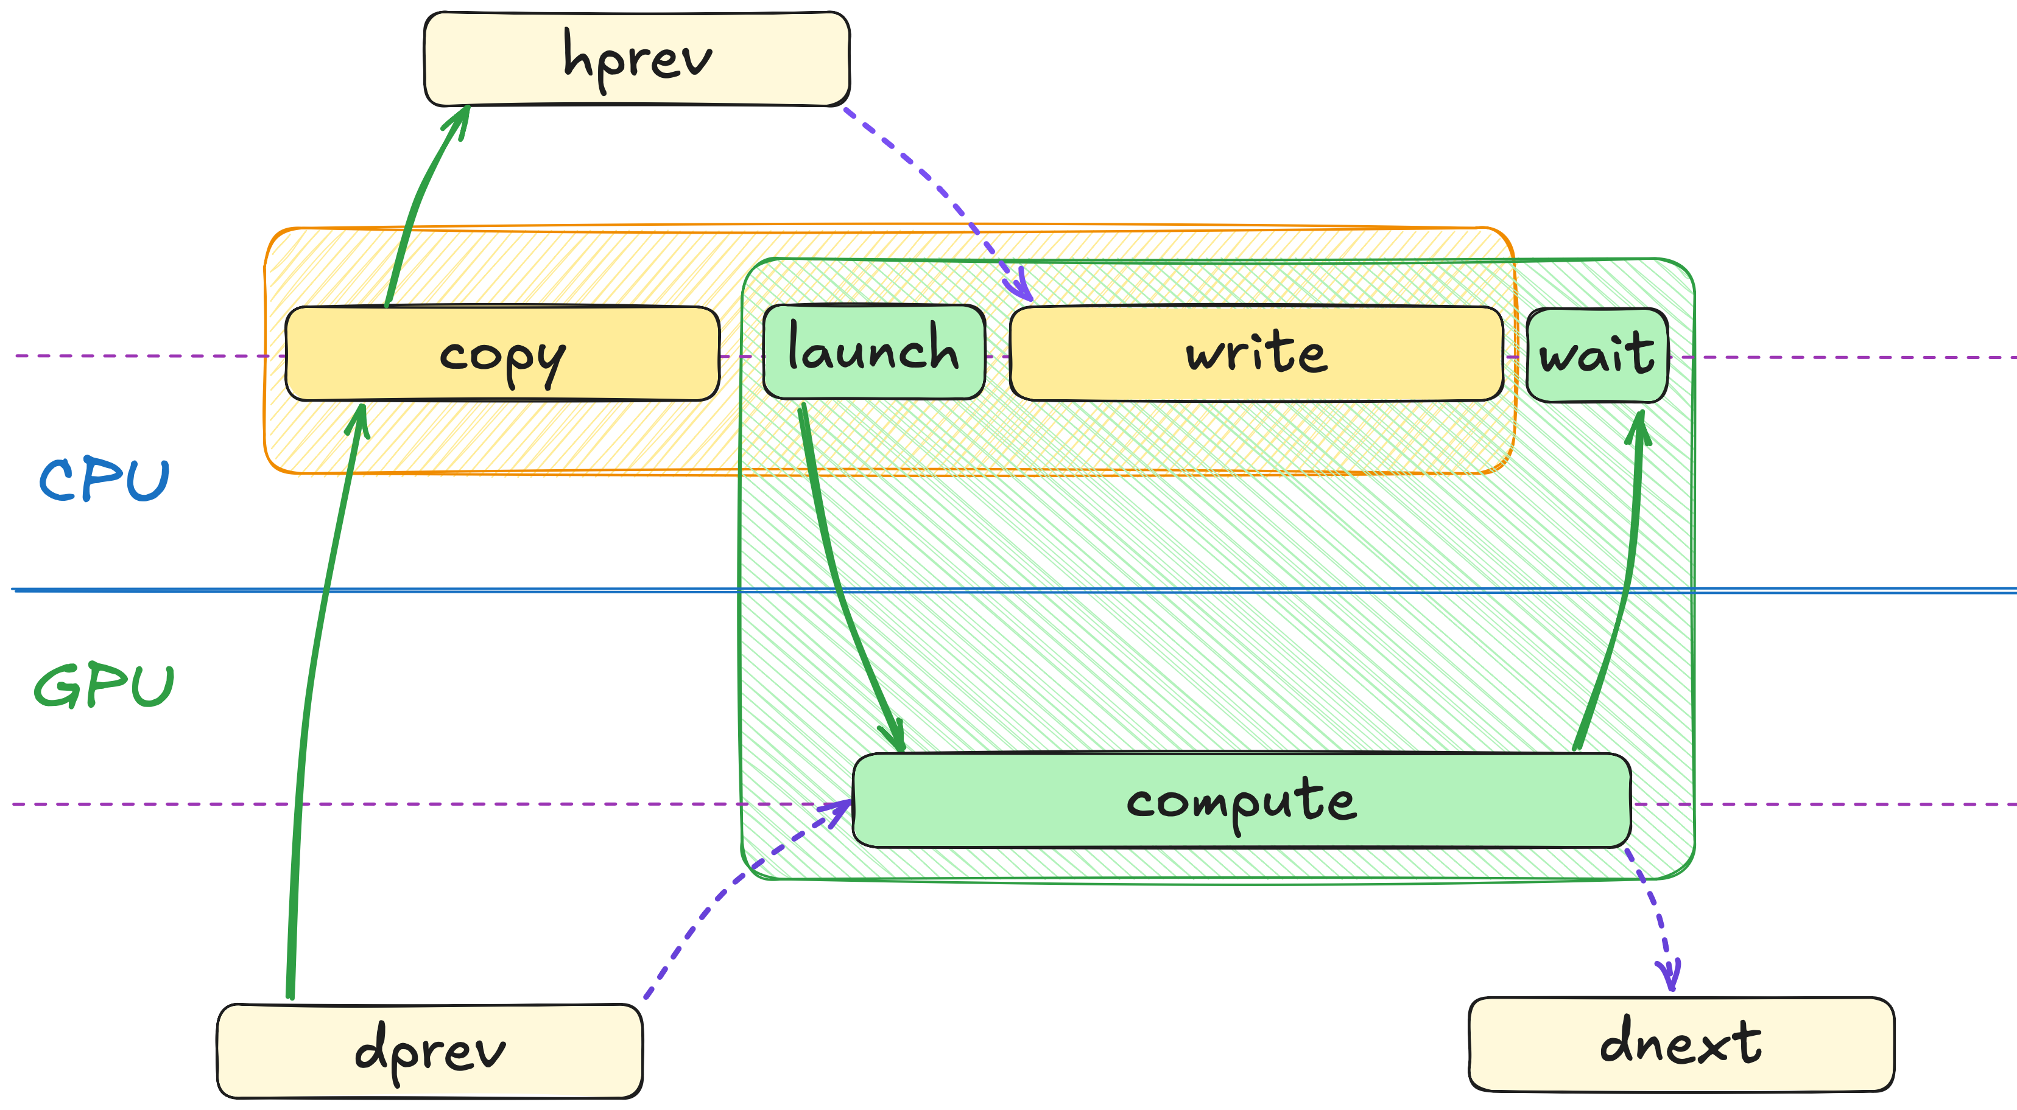
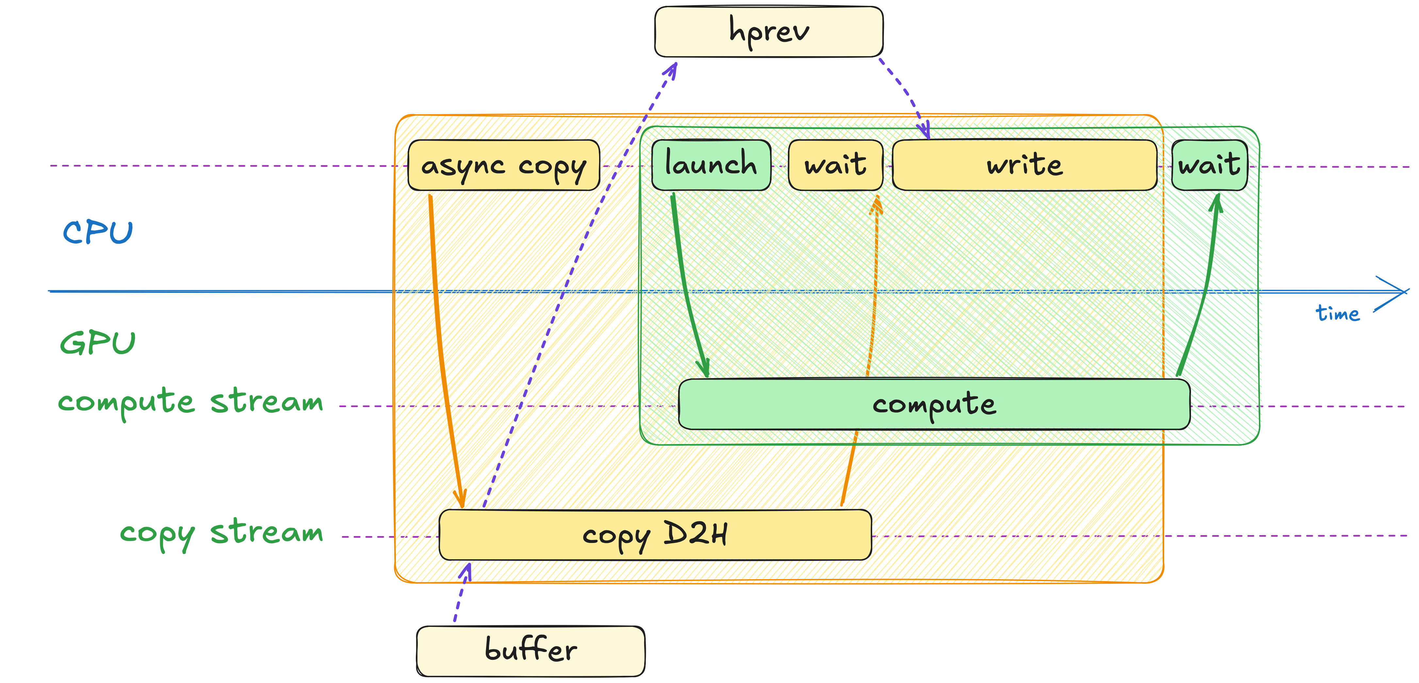
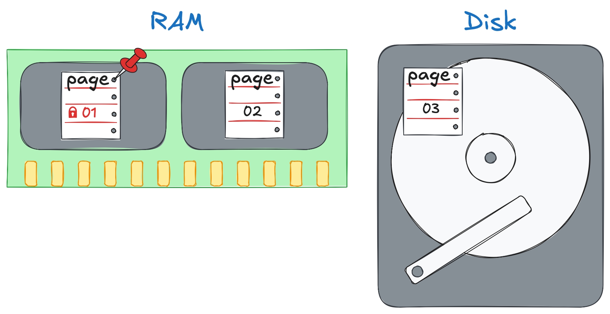
Section at a Glance
Learn the notion of 2.2 Asynchrony as we overlap computation and IO to achieve 2x speedup
Learn the notion of 2.3 CUDA Streams as we overlap computation with memory transfers
Learn the notion of 2.4 Pinned Memory as we make memory transfers asynchronous
Notes:
Here’s how this section is organized.
First, we’ll explore the concept of asynchrony, which lets us overlap computation with I/O.
Next, we’ll learn how CUDA streams enable concurrent CPU-GPU data transfers.
Finally, we’ll explore new aspects of the memory subsystem that support efficient data movement.

Slide 3
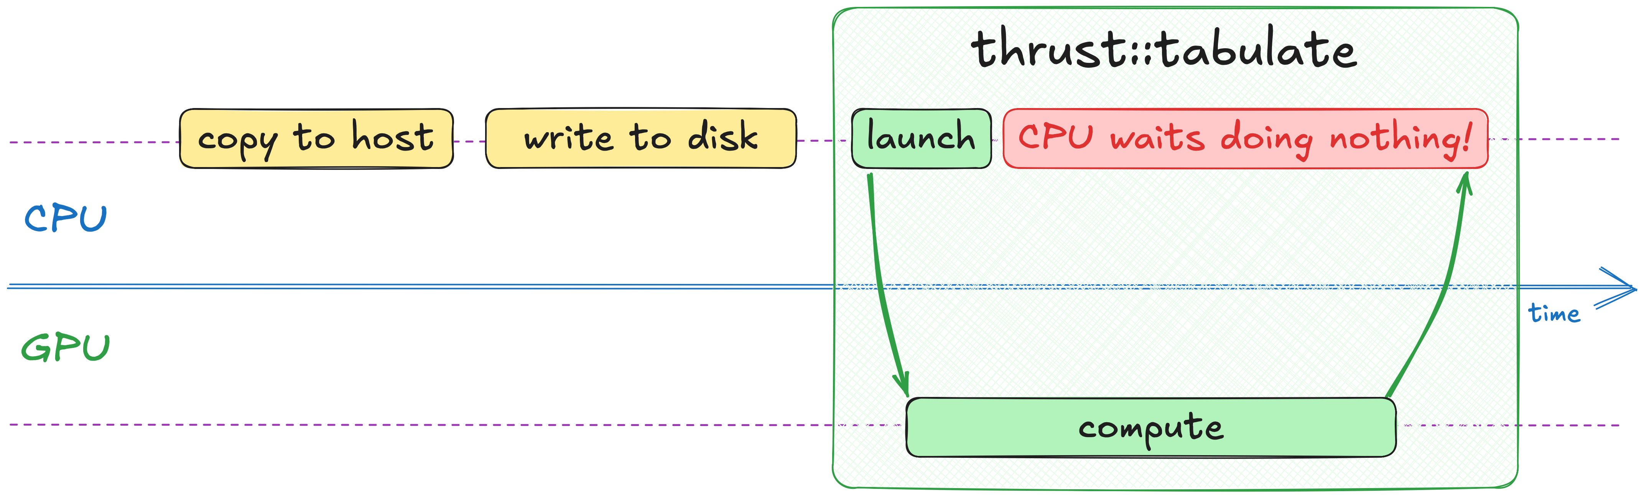
Recap of Current State
Copy previous data to CPU and write it to disk
Invoke thrust::tabulate that reads previous state and writes next one
Notes:
Let’s review the current state of our heat equation simulator.
First, we copy the data from the GPU to the host, then we write it to disk, and finally, we use thrust::tabulate to compute the next set of temperatures on the GPU.

Slide 4
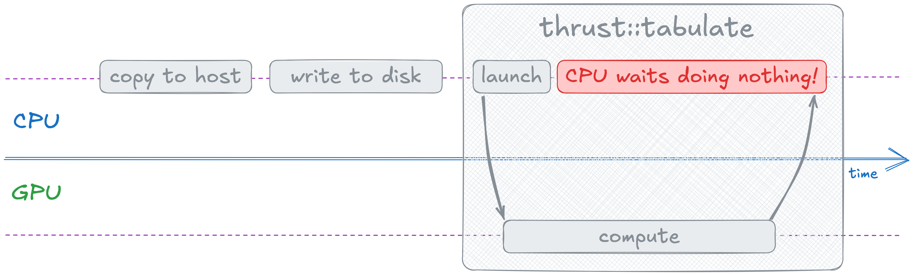
Idle Resources
Under the hood, Thrust launches work on GPU and waits for it to finish (synchronous)
Writing efficient heterogeneous program means utilizing all recourses, including CPU
Can we find anything useful for CPU to do while GPU is busy?
Notes:
Under the hood, Thrust launches work on the GPU and waits for it to finish.
Because thrust::tabulate doesn’t return control until the transformation is complete, the CPU stays idle.
This is a missed opportunity! Writing an efficient heterogeneous program means making full use of all resources.
This includes the CPU as well.
So, can we find anything meaningful for the CPU to do while the GPU is busy?

Slide 5
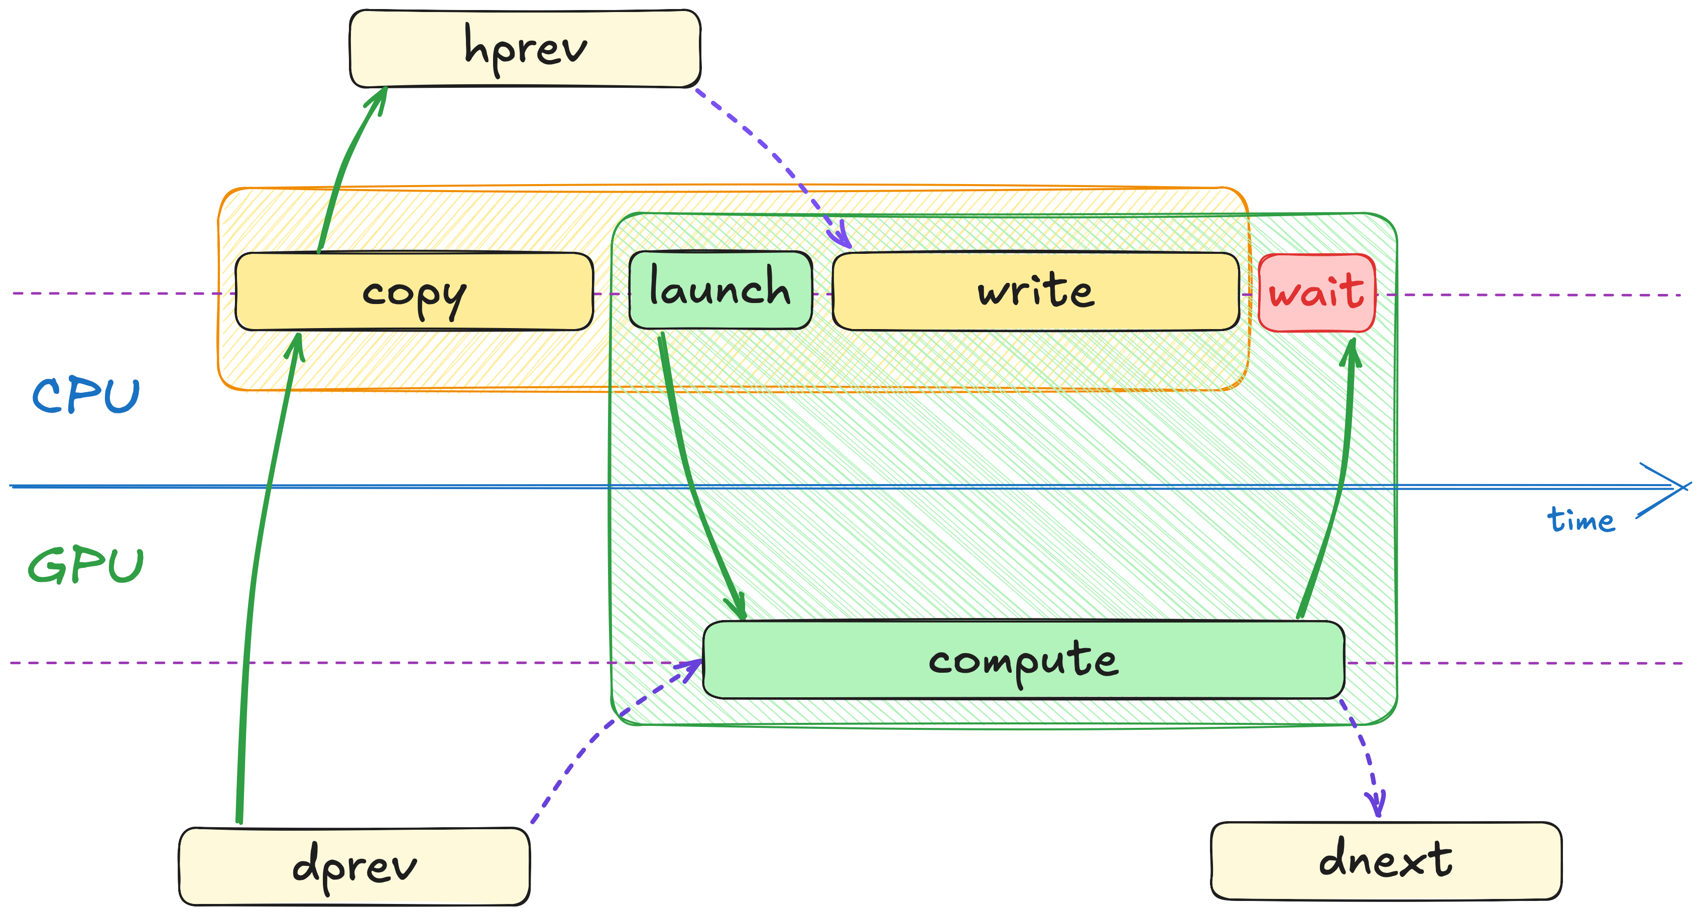
Data Dependency
Write step reads host copy of previous state
Compute step reads device copy of previous state
So, there’s no dependency between the two
Meaning that CPU can spend time writing results on disk
But that’d require splitting Thrust call into launch and wait
Notes:
To answer this question, let’s take a look at the data dependencies.
The write step reads from the host copy of the previous temperatures, while the compute step reads from the device copy.
Because these operations use separate data, they don’t depend on each other.
As a result, the CPU can write results to disk while the GPU computes the next temperatures.
To achieve this overlap, we’d ideally split the Thrust call into separate launching and waiting steps.
Unfortunately, Thrust doesn’t support that.
The good news is that Thrust doesn’t implement its algorithms directly.
Instead, it relies on another core library called CUB to handle work on the GPU.
Let’s take a closer look at CUB to see if it can help us overlap compute and IO.

Slide 6
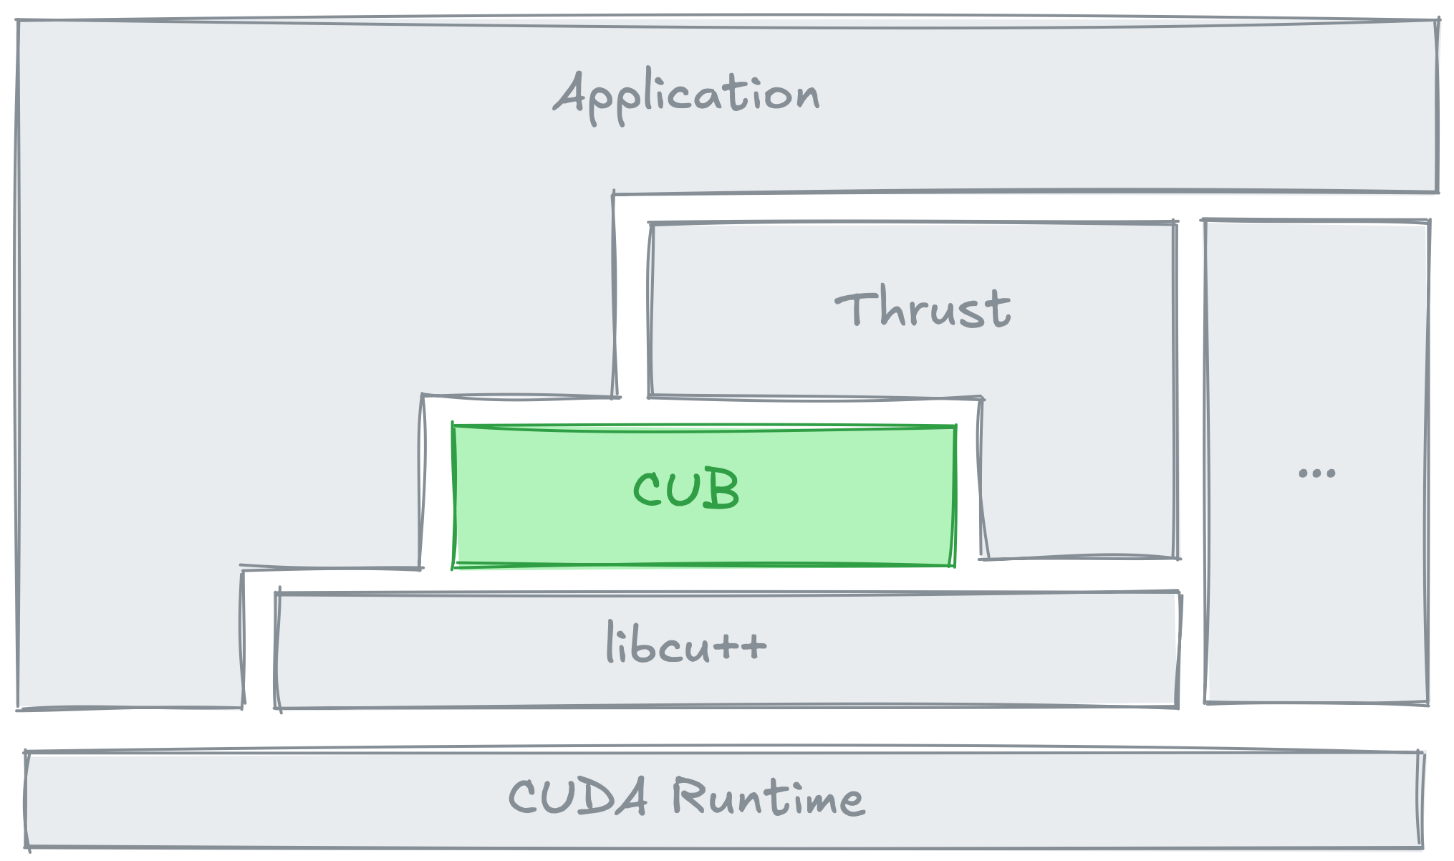
CUB
Sorting
cub::DeviceTransform
cub::DeviceRadixSort
...
Iterators
cub::CacheModifiedInputIterator
cub::CacheModifiedOutputIterator
...
Types
cub::FutureValue
cub::DoubleBuffer
...
https://nvidia.github.io/cccl/cub
Notes:
CUB offers many of the same parallel algorithms found in Thrust, but it doesn’t follow the standard C++ API.
It’s also CUDA-specific, meaning it doesn’t provide any host-side implementations like Thrust does.

Slide 7
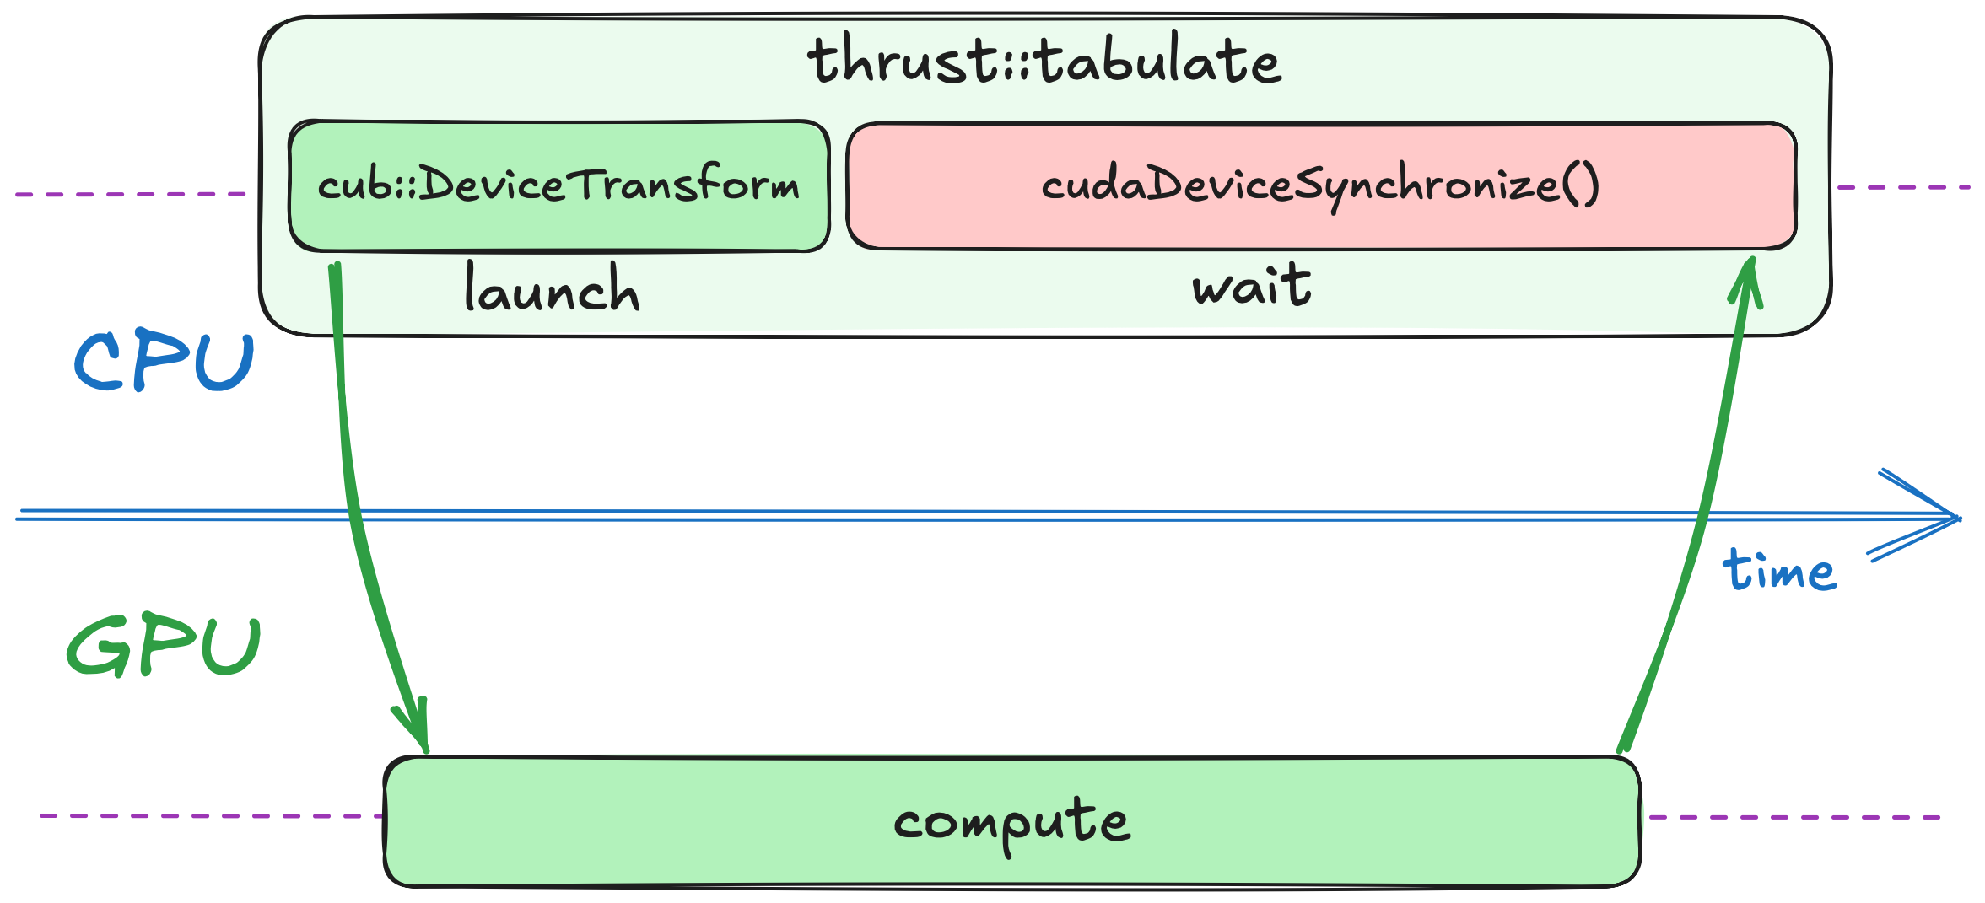
Synchronous vs Asynchronous
Thrust calls into another layer of CUDA Core Libraries called CUB
Unlike Thrust, CUB is asynchronous (control flow doesn’t wait for algorithm to finish)
To synchronize with all asynchronous work on GPU, Thrust uses cudaDeviceSynchronize
Notes:
Under the hood, Thrust calls into another layer of the CUDA Core Libraries called CUB.
CUB is asynchronous, so once you launch an operation, it immediately hands control back to the CPU instead of waiting for the GPU to finish.
After launching CUB algorithm, Thrust uses cudaDeviceSynchronize to wait for CUB algorithm completion.
This cudaDeviceSynchronize is part of the CUDA Runtime.
It essentially blocks the CPU thread until every preceding GPU operations have completed.

Slide 8
CUB is Asynchronous
Thrust
auto begin = std::chrono::high_resolution_clock::now();
thrust::tabulate(thrust::device, out.begin(), out.end(), compute);
auto end = std::chrono::high_resolution_clock::now();
CUB
auto begin = std::chrono::high_resolution_clock::now();
auto cell_ids = thrust::make_counting_iterator(0);
cub::DeviceTransform::Transform(cell_ids, out.begin(), num_cells, compute);
auto end = std::chrono::high_resolution_clock::now();
CPU doesn’t wait for the transformation to finish before executing the next instruction (recording end time)
That’s why CUB elapsed time doesn’t scale with problem size
Notes:
Asynchrony is a key concept in GPU programming, and the example on this slide shows why.
In the first snippet, we use thrust::tabulate.
Thrust is synchronous, so our timer doesn’t stop until the GPU has completely finished the work.
In the second snippet, we use CUB’s DeviceTransform function, which is asynchronous.
That means it returns control to the CPU right away, even if the GPU is still computing.
As a result, when we record the end time, the GPU hasn’t actually finished yet, so it looks like CUB takes no time at all.
Increasing the problem size doesn’t change that timing, because the CPU never waits for the GPU to finish.
This illustrates what asynchronous execution really means: the CPU and GPU can work in parallel.
That’s why timing measurements can be misleading if you don’t explicitly synchronize before checking how long the GPU work took.

Slide 9
Explicit Device Synchronization
Thrust
auto begin = std::chrono::high_resolution_clock::now();
thrust::tabulate(thrust::device, out.begin(), out.end(), compute);
auto end = std::chrono::high_resolution_clock::now();
CUB
auto begin = std::chrono::high_resolution_clock::now();
auto cell_ids = thrust::make_counting_iterator(0);
cub::DeviceTransform::Transform(cell_ids, out.begin(), num_cells, compute);
cudaDeviceSynchronize();
auto end = std::chrono::high_resolution_clock::now();
cudaDeviceSynchronize
is part of CUDA Runtime
blocks until all work on GPU finishes
Makes CUB version synchronous as well
Notes:
So, let’s do exactly that.
By adding the cudaDeviceSynchronize call we mentioned earlier, we force the CPU to wait until all GPU work is complete.
Once we add this synchronization, both CUB and Thrust show equivalent performance results.
The question then becomes: how do we take advantage of this asynchronous behavior?

Slide 10
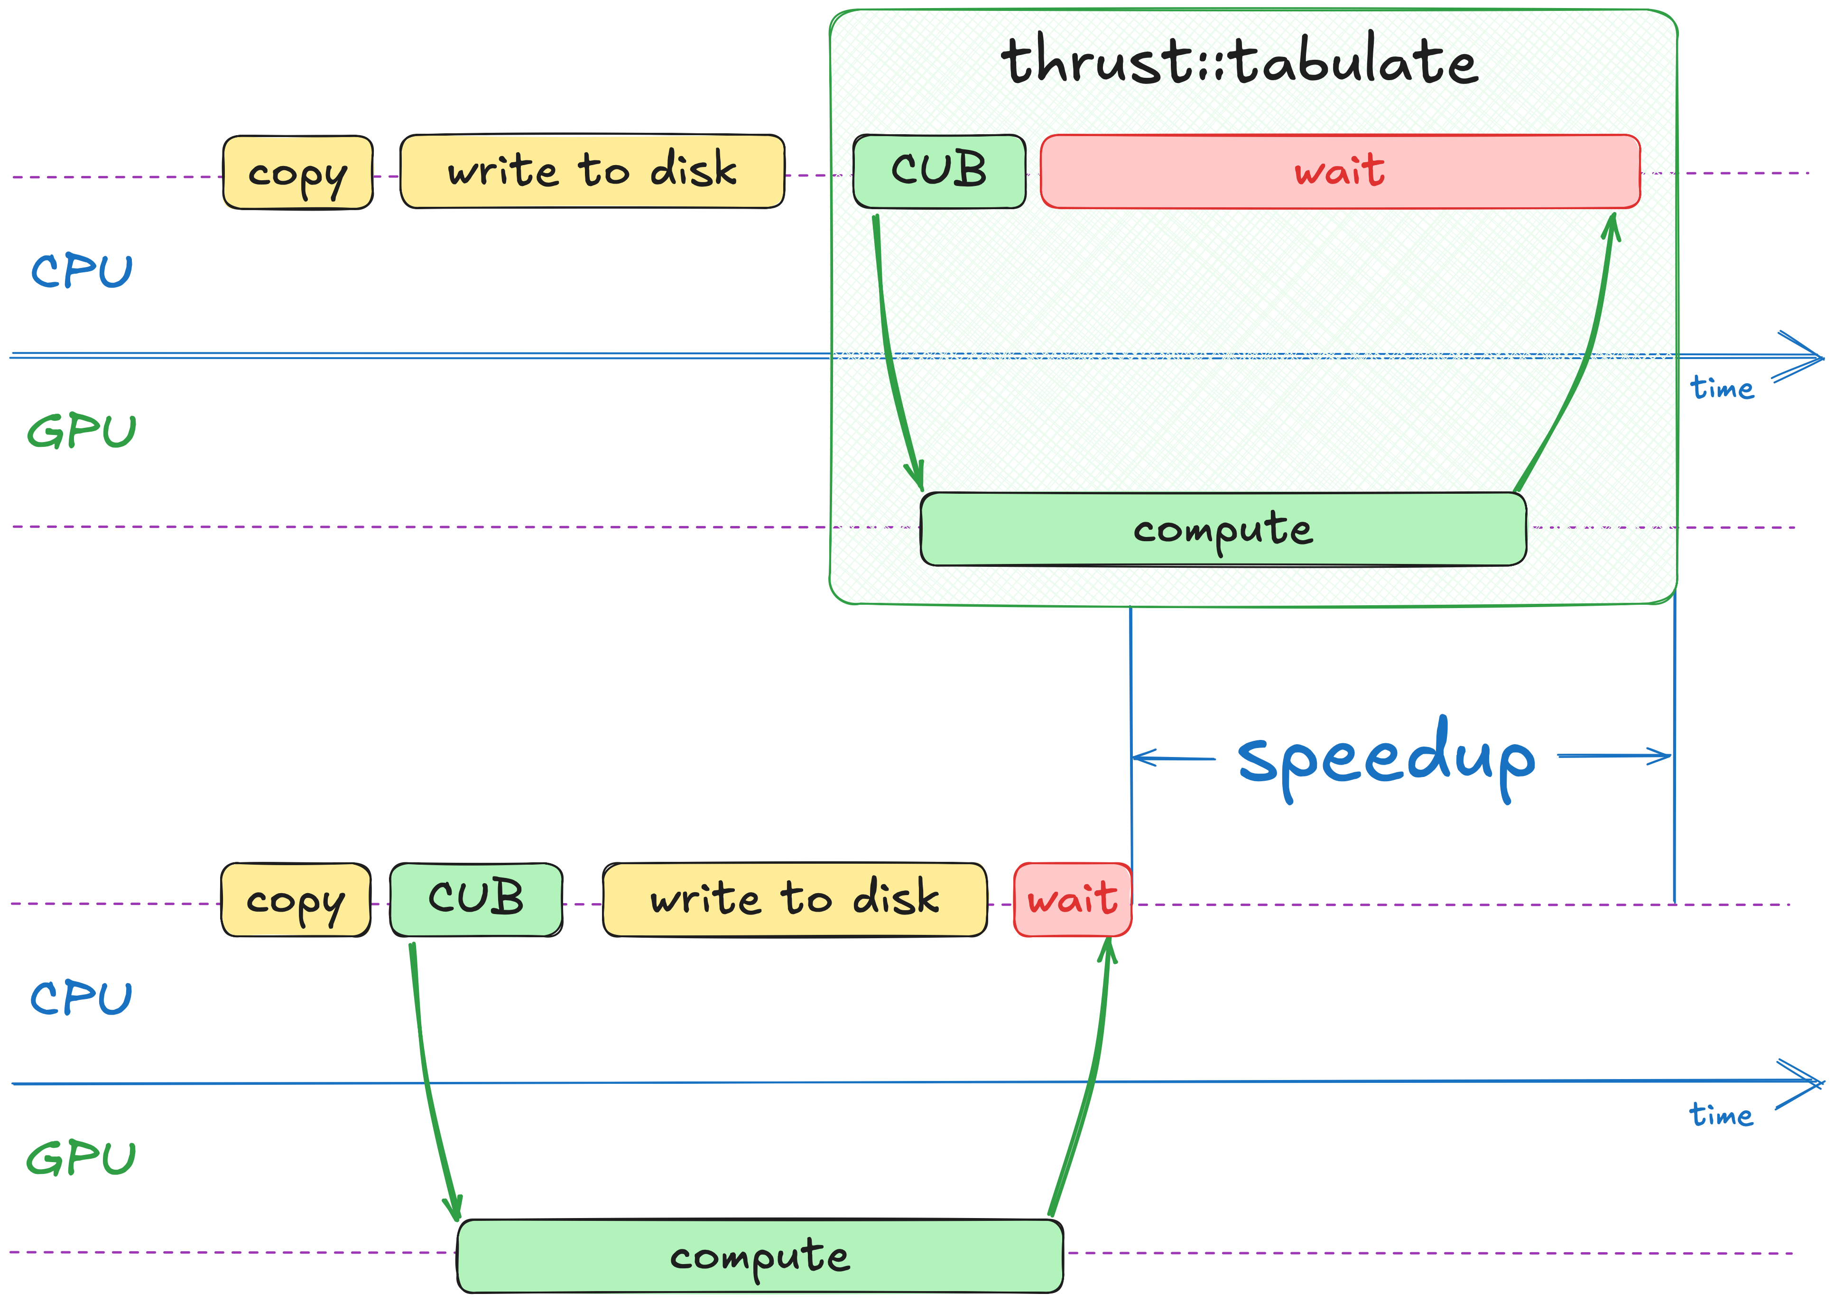
Synchronous vs Asynchronous
By using asynchronous CUB API along with CUDA Runtime directly, we can keep CPU busy with writing results on disk
This should result in speedup
Notes:
Now we can finally split our Thrust call into separate launch and wait steps.
When we launch asynchronous work with CUB, the CPU is freed immediately, allowing us to start writing data to disk while the GPU continues computing.
We then synchronize with the GPU only after it finishes.
Since we would have waited for the GPU anyway, we’re not losing any time.
Instead, the wait step becomes shorter, leading to more efficient use of the system.
As a result, we can expect a significant performance boost from this approach.”

Slide 11
Exercise: Compute-IO Overlap
10 minutes
Replace thrust::tabulate
Add cudaDeviceSynchronize after storing results on disk to match scheme on the right
thrust::tabulate(
thrust::device, out.begin(), out.end(),
compute);
with cub::DeviceTransform::Transform
auto cell_ids =
thrust::make_counting_iterator(0);
cub::DeviceTransform::Transform(
cell_ids, out.begin(), num_cells,
compute);
02.02-Asynchrony/02.02.02-Exercise-Compute-IO-Overlap.ipynb
Notes:
Which brings us to our next exercise.
This time, you’ll replace thrust::tabulate with cub::DeviceTransform to make the computation asynchronous.
You’ll also add a cudaDeviceSynchronize call after writing the results to disk, following the scheme shown on the right.
For this, you’ll have 10 minutes starting now.

Slide 12
Exercise: Compute-IO Overlap
Solution
CUB returns control immediately without waiting for transformation to finish
thrust::copy(dprev.begin(), dprev.end(), hprev.begin());
for (int step = 0; step < steps; step++)
{
simulate(height, width, dprev, dnext);
dprev.swap(dnext);
}
store(write, height, width, hprev);
cudaDeviceSynchronize();
void simulate(int width,
int height,
const thrust::device_vector<float> &in,
thrust::device_vector<float> &out)
{
// ...
auto cell_ids = thrust::make_counting_iterator(0);
cub::DeviceTransform::Transform(
cell_ids, out.begin(),
width * height,
compute);
}
Notes:
Time’s up! Let’s review the solution.
We replace thrust::tabulate with cub::DeviceTransform in the simulate function, since tabulate is essentially just a transformation of a counting iterator.
Once the GPU computation is launched asynchronously, we can do other CPU work - in this case, writing data to disk.

Slide 13
Exercise: Compute-IO Overlap
Solution
CUB returns control immediately without waiting for transformation to finish
So, we must add cudaDeviceSynchronize explicitly
thrust::copy(dprev.begin(), dprev.end(), hprev.begin());
for (int step = 0; step < steps; step++)
{
simulate(height, width, dprev, dnext);
dprev.swap(dnext);
}
store(write, height, width, hprev);
cudaDeviceSynchronize();
void simulate(int width,
int height,
const thrust::device_vector<float> &in,
thrust::device_vector<float> &out)
{
// ...
auto cell_ids = thrust::make_counting_iterator(0);
cub::DeviceTransform::Transform(
cell_ids, out.begin(),
width * height,
compute);
}
Notes:
After writing results on disk, we add cudaDeviceSynchronize to wait for GPU to finish all work.

Slide 14
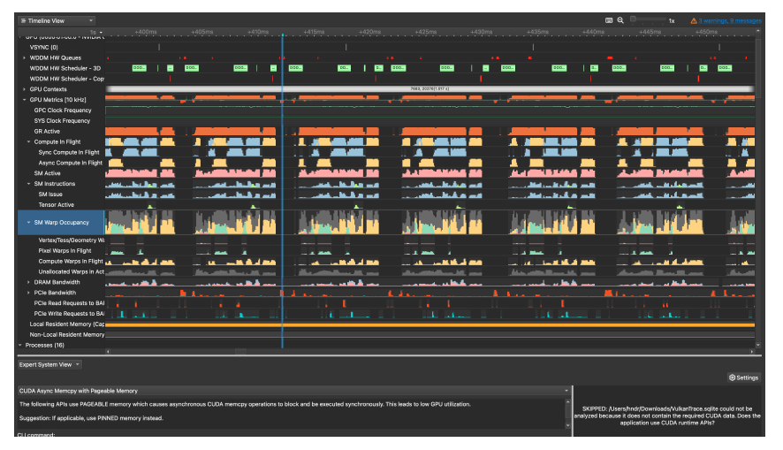
Nsight Systems
Nsight Systems provides system-wide view of GPU and CPU activities
It visually represents asynchronous compute and memory transfers
It allows us to visually identify optimization opportunities
Notes:
As we dive deeper into asynchronous execution, profiling and debugging can get tricky.
It’s not always clear when tasks overlap, or if the CPU and GPU are being fully utilized.
This is where Nsight Systems steps in.
Nsight Systems gives you a system-wide view of both GPU and CPU activities, visually representing asynchronous operations.
By showing you exactly when and where each task runs, it highlights potential bottlenecks and uncovers new opportunities for optimization.
Let’s take a closer look at how we can use this tool to fine-tune our asynchronous workflows.

Slide 15
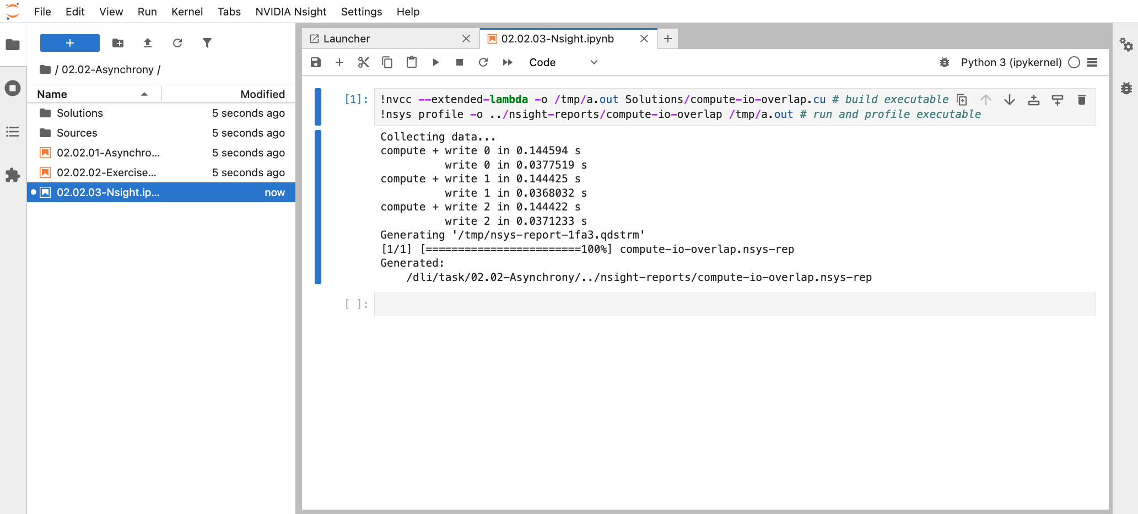
Exercise: Profile Your Code with Nsight Systems
10 minutes
02.02-Asynchrony/02.02.03-Exercise-Nsight.ipynb
Notes:
In this exercise, you’ll learn how to profile your code with Nsight Systems.
We’ll use the command-line tool called nsys to collect performance data.
First, open exercise you see on the screen, and execute the cell.

Slide 16
Exercise: Profile Your Code with Nsight Systems
10 minutes
Profile your app with nsys profile and store the report file
Notes:
This cell stores the Nsight profile in a file called compute-io-overlap inside the nsight-reports directory.

Slide 17
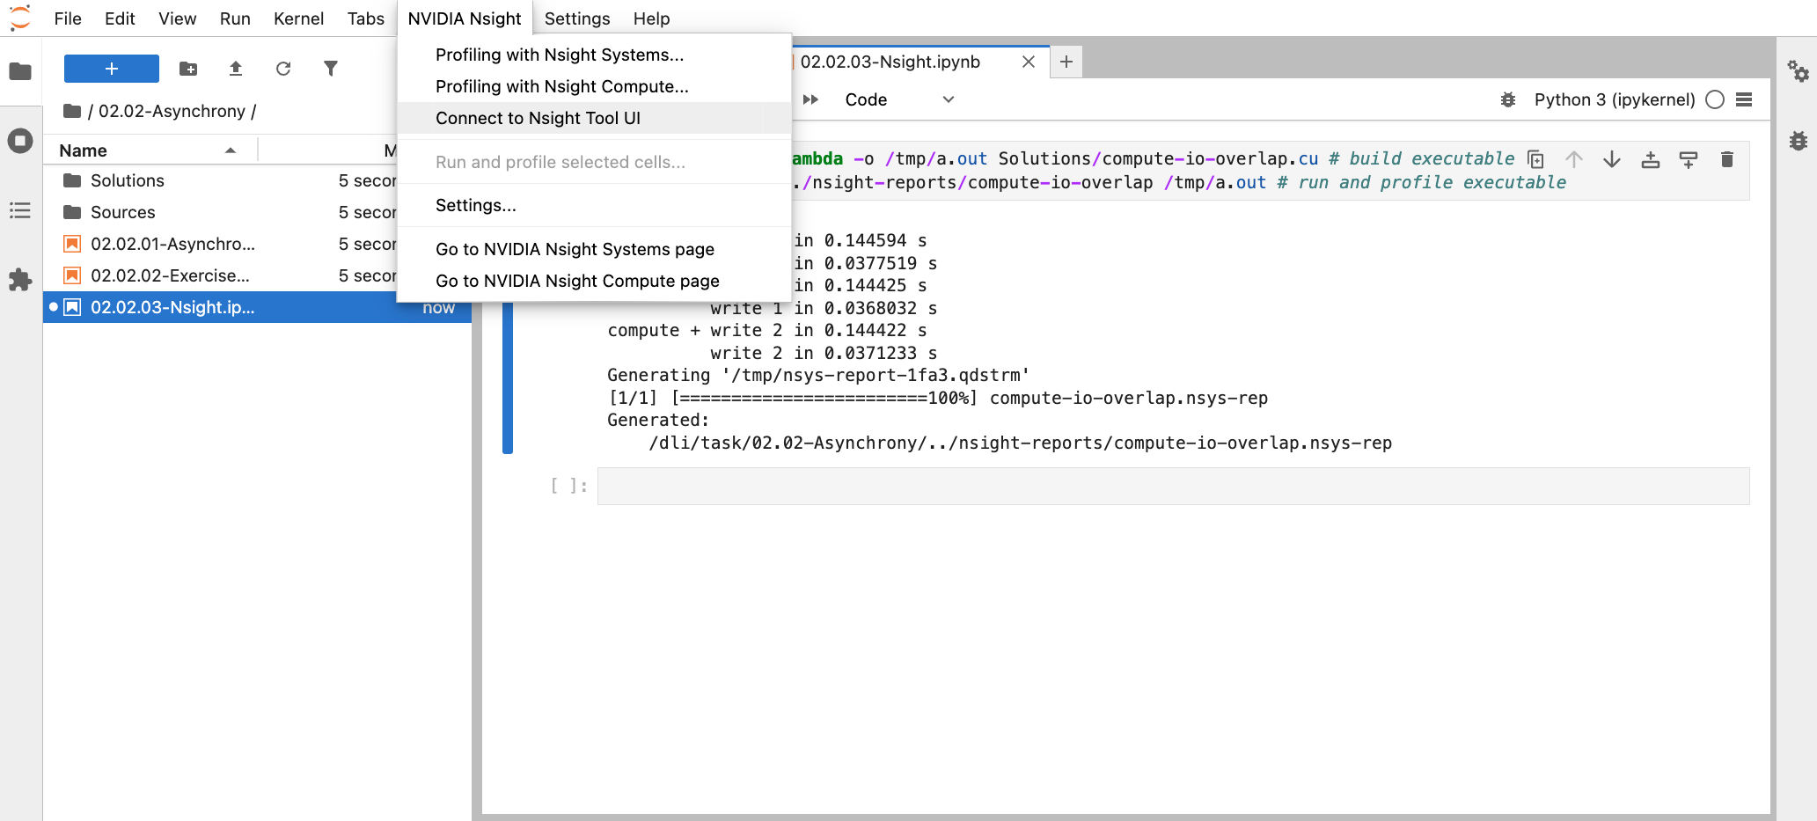
Exercise: Profile Your Code with Nsight Systems
You you can’t get pass the “connecting to the server”, consider refreshing the page
Click “Connect to Nsight Tool UI” in the “NVIDIA Nsight” tab
Notes:
To view the report, let's launch the graphical user interface.
To do that, navigate to the "NVIDIA Nsight" tab and select "Connect to Nsight Tool UI".
Click "Ok" in the dialog box.
The remote desktop will open in a new tab within JupyterLab.

Slide 18
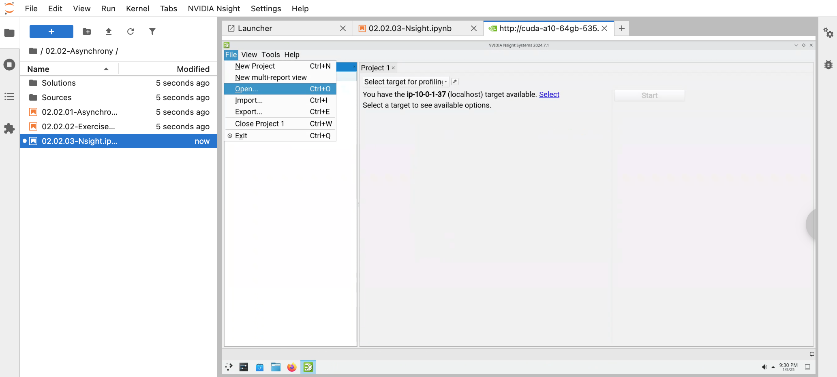
Exercise: Profile Your Code with Nsight Systems
Open Nsight Systems: File – Open…
Notes:
After the remote desktop connects, you'll see a "START" button.
Click on it to open the desktop.
Then, launch "Nsight Systems" from the desktop and maximize it.

Slide 19
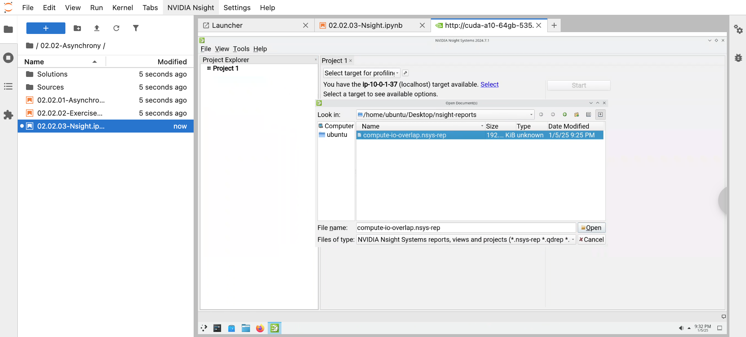
Exercise: Profile Your Code with Nsight Systems
Navigate to the report you just saved
Notes:
Then open the report file that we generated earlier.
You'll find it with File->Open from the menu.
Then navigate to Desktop / nsight-reports directory.

Slide 20
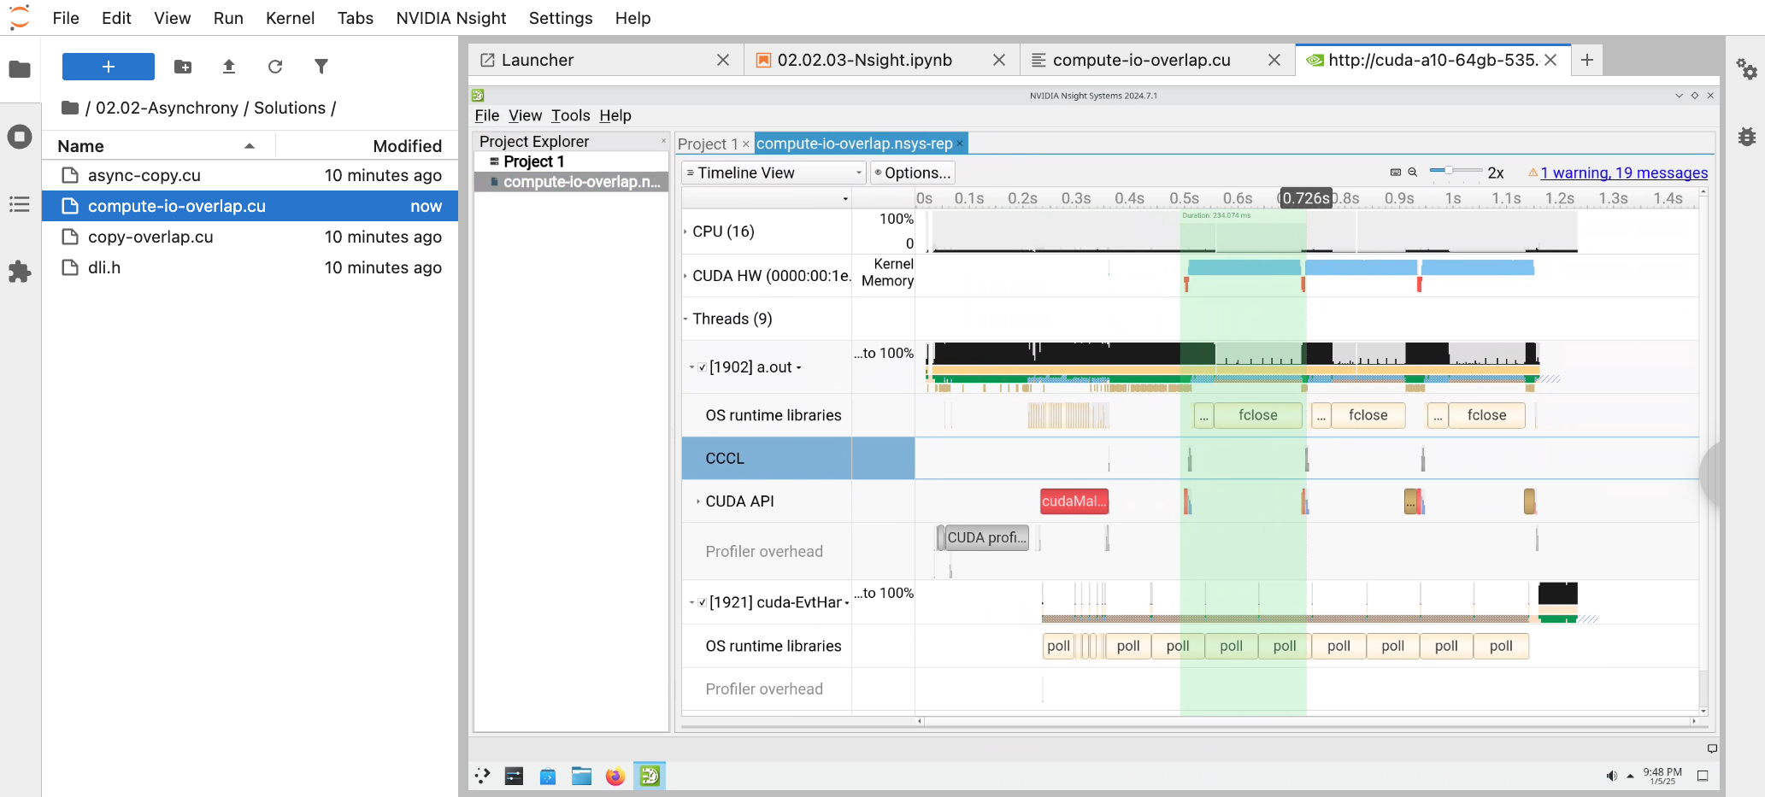
Exercise: Profile Your Code with Nsight Systems
Click and drag to select a time region
Notes:
To navigate the profile, you can click on the timeline view and drag your mouse to select a time region.

Slide 21
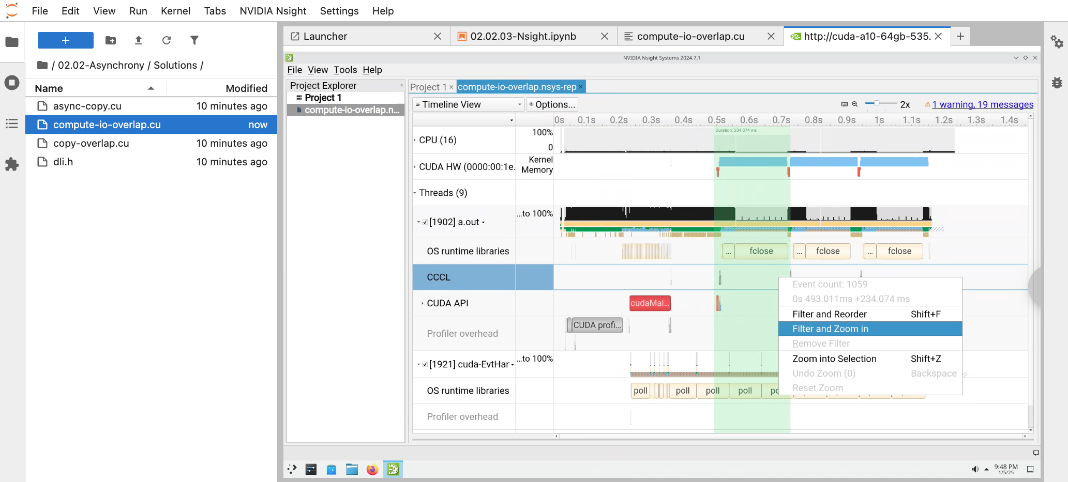
Exercise: Profile Your Code with Nsight Systems
Click “Filter and Zoom in”
Notes:
With right click, you should be able to see the pop-up menu, where you can zoom into selected time region.

Slide 22
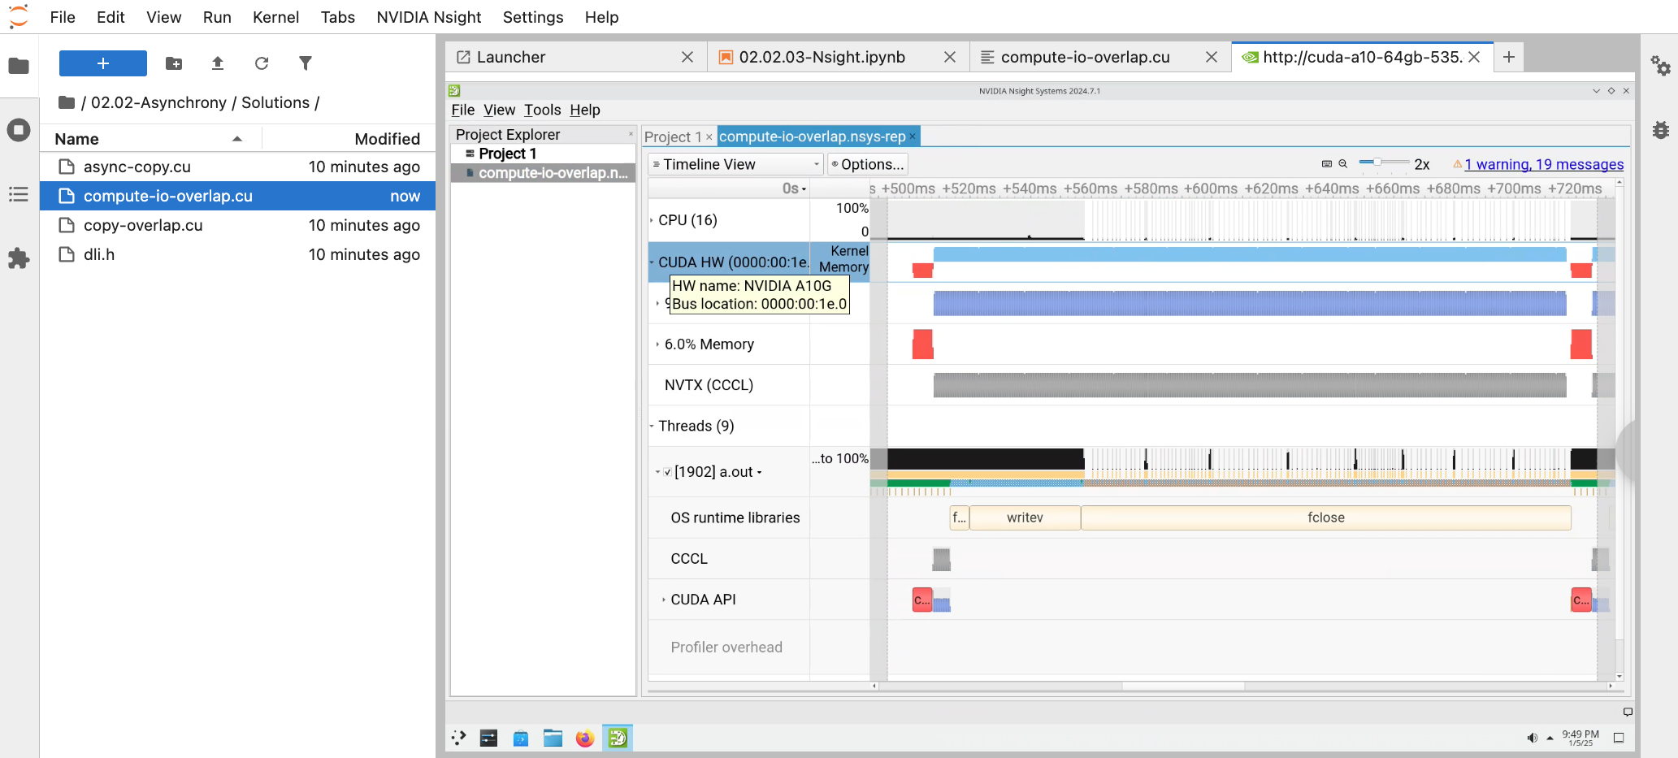
Exercise: Profile Your Code with Nsight Systems
Unfold “CUDA HW” to see more details on what GPU is doing
Notes:
You’ll also want to unfold the ”CUDA HW” section to see more details on what is happening on the GPU end

Slide 23
Exercise: Profile Your Code with Nsight Systems
10 minutes
Look around the timeline of Desktop/nsight-reports/compute-io-overlap.nsys-rep to identify:
when GPU compute is launched
when CPU writes data on disk
when CPU waits for GPU
when data is transferred
02.02-Asynchrony/02.02.03-Exercise-Nsight.ipynb
Notes:
Overall, your task is to look around the timeline of the profile that we just generated and identify:
- when GPU compute is launched
- when CPU writes data on disk
when CPU waits for GPU
and finally, when the data is transferred between CPU and GPU
For this, you have 10 minutes starting now.

Slide 24
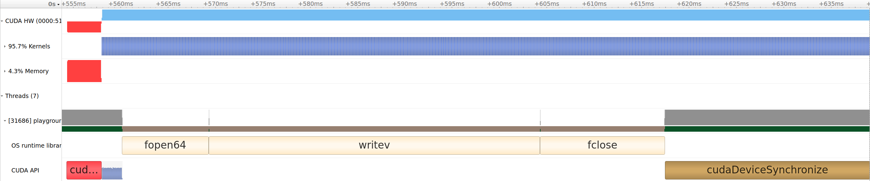
Exercise: Profile code with Nsight
Solution
compute
GPU
CPU
copy
Notes:
Time’s up!
Let’s take a look at the solution.
Our write step starts with a copy from GPU to CPU memory space.

Slide 25
Exercise: Profile code with Nsight
Solution
compute
GPU
CPU
launch
wait
Algorithms are now asynchronous
Synchronization with GPU is now explicit
Notes:
Additionally, notice how the compute is initiated by the CPU but actually runs on the GPU.
The cudaDeviceSynchronize call, which marks the end of each iteration, is clearly visible as well.
You can see how it holds up the CPU until the final kernel has finished executing on the GPU, before handing control flow back to the CPU.

Slide 26
Exercise: Profile code with Nsight
GPU
CPU
write
Algorithms are now asynchronous
Synchronization with GPU is now explicit
Compute on GPU now overlaps writing on CPU
Notes:
If you’re familiar with operating system calls, you’ll spot fopen, writev, and fclose on the CPU timeline.
These indicate that the CPU was writing results to disk.
Notice how this disk I/O overlaps with GPU computation, which you can see happening at the same time.
Thanks to profiling with Nsight Systems, we don’t have to guess if overlapping actually occurs.
We can just see it right here in the timeline.

Slide 27
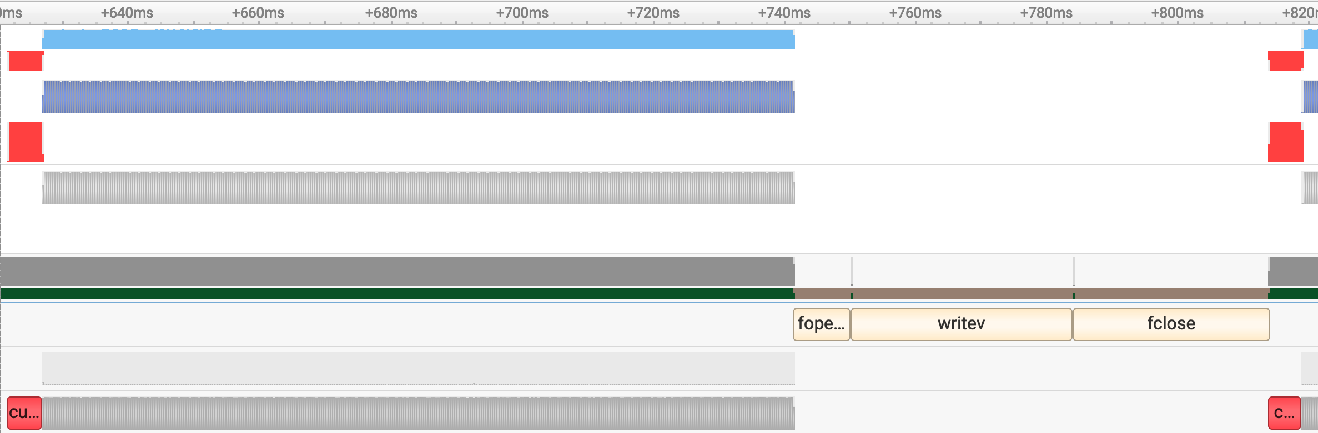
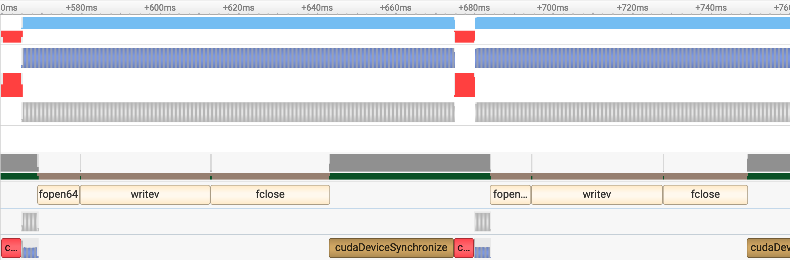
Synchronous vs Asynchronous
Synchronous
GPU
CPU
Asynchronous
Our simulation has enough compute to fully overlap IO
This makes version with compute / IO overlap almost twice as fast
GPU
CPU
Notes:
If you profile the earlier version of our simulator, you’ll see a clear performance difference.
The synchronous API blocks after each call, which delays disk writes until all computations are finished, so no overlap.
In contrast, the new asynchronous version fully overlaps computation and I/O, making the disk writes effectively ‘free’ and yielding about a 2x speedup.
That said, analyzing these differences still involves matching what you see in the timeline with your code, which can be cumbersome.
Fortunately, there’s a way to simplify profiling even further.

Slide 28
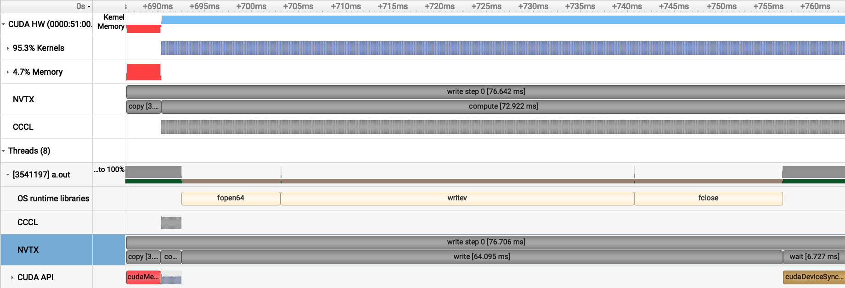
NVIDIA Tools Extension (NVTX)
https://github.com/NVIDIA/NVTX
Inspecting Nsight report for a complex application can be intimidating
NVTX allows you to create custom ranges in Nsight Systems from code
int main()
{
for (int write_step = 0; write_step < write_steps; write_step++)
{
nvtx3::scoped_range r{std::string("write step ") + std::to_string(write_step)};
...
}
}
Notes:
When you’re working on a complex application, interpreting Nsight report can be overwhelming.
That’s where NVTX, the NVIDIA Tools Extension, comes in.
NVTX allows you to insert custom markers and ranges directly into your code, so that when you view the Nsight report, your labels appear in the timeline.
In the code on the slide, we use `nvtx3::scoped_range` to label each write step.
The range starts at the beginning of the loop iteration and ends automatically when it goes out of scope.
This helps you instantly map parts of the timeline to the code you write.

Slide 29
Exercise: Use NVTX
8 minutes
Use nvtx3::scoped_range to annotate copy, compute, write, and wait steps
Profile your application with Nsight Systems and locate specified ranges
int main()
{
for (int write_step = 0; write_step < write_steps; write_step++)
{
nvtx3::scoped_range r{std::string("write step ") + std::to_string(write_step)};
...
}
}
02.02-Asynchrony/02.02.04-Exercise-NVTX.ipynb
Notes:
[optional – if time permits]
Which brings us the the next exercise.
This time, you’ll have to annotate copy, compute, write, and wait steps using NVTX ranges.
Then, profile the simulator with Nsight systems and try locating specified ranges.
For this, you’ll have 8 minutes starting now.

Slide 30
Exercise: Use NVTX
Solution
GPU
CPU
Now all the steps are much easier to locate
Notes:
[optional – if time permits]
After making those changes, your Nsight timeline should look something like this.
Notice how each labeled range clearly marks where every step begins and ends.
This visual labeling makes it much easier to spot precisely what’s happening at each point in your application

Slide 31
CUDA Streams
Observe how compute unnecessarily waits for copy to finish
Fortunately, there’s cudaMemcpyAsync, that can make copy asynchronous as well
Notes:
At this point, we’ve learned how to use asynchrony to overlap CPU and GPU tasks, leading to a big performance boost.
Our code now copies data from the GPU to the CPU, launches an asynchronous computation with CUB, and then writes results to disk.
However, there’s still room for improvement: the GPU compute doesn’t actually have to wait for the copy to finish.
We can apply the same overlapping strategy to the copy and compute steps.
But this will require the copy to be asynchronous.
Fortunately, Thrust itself doesn’t have any special mechanism to transfer data.
Under the hood, it relies on the CUDA Runtime function called cudaMemcpyAsync.
This function can copy data between host and device memory without blocking.
Let’s take a closer look at how we can use it to overlap our copy and compute steps.

Slide 32
CUDA Streams
cudaMemcpyAsync is the magic behind thrust::copy
Warning:
Not type-save
Operates in bytes not elements
Explicitly specified copy direction
Asynchronous errors are easy to miss
cudaError_t cudaMemcpyAsync(
void* dst,
const void* src,
size_t count,
cudaMemcpyKind kind
);
Destination memory address
Source memory address
Size in bytes to copy
cudaMemcpyHostToHost
cudaMemcpyHostToDevice
cudaMemcpyDeviceToHost
cudaMemcpyDeviceToDevice
Notes:
Let’s begin with the cudaMemcpyAsync interface, which essentially powers thrust::copy. \
It handles asynchronous data transfers between host and device memory, but there are a few important pitfalls to keep in mind.
First, cudaMemcpyAsync isn’t type-safe - it won’t verify that the source and destination types match.
Second, it operates in bytes rather than elements, so you need to multiply the number of elements by the size of each element to avoid mistakes.
Third, you must explicitly indicate whether the transfer is host-to-device, device-to-host, or device-to-device using the cudaMemcpyKind parameter.
Finally, cudaMemcpyAsync returns an error code, which you should always check.
In a moment, we’ll take a closer look at what these errors might mean and how to handle them.

Slide 33
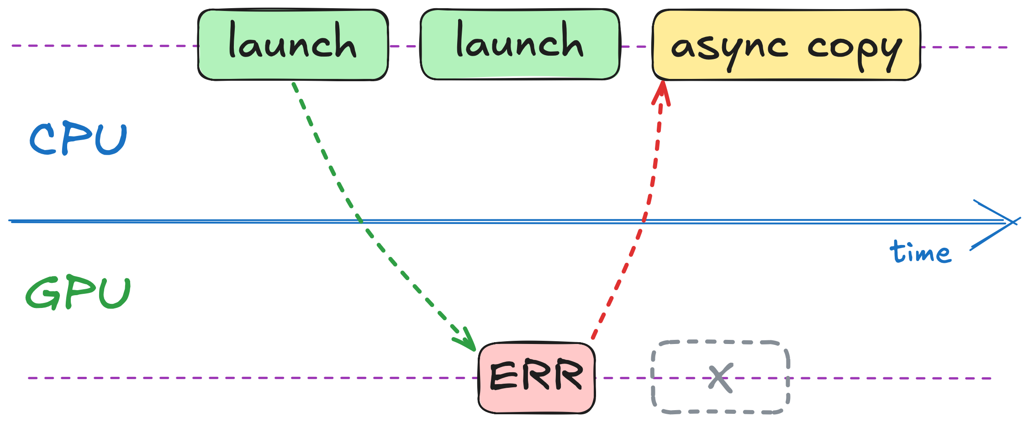
CUDA Errors
What kind of error does cudaMemcpyAsync return?
The error can be caused any prior asynchronous operation
cudaError_t cudaMemcpyAsync(
void* dst,
const void* src,
size_t count,
cudaMemcpyKind kind
);
Notes:
[optional – if time permits]
One subtlety of asynchronous operations is that errors don’t always surface where they occur.
For example, you could launch a kernel that goes out of bounds, but the GPU won’t actually start executing it right away.
Meanwhile, you might launch another kernel, that doesn’t observe the error from the prior kernel, since it hasn’t started running yet.
But then cudaMemcpyAsync checks the GPU’s status and discovers the error from the earlier kernel.
In other words, an error triggered by any prior asynchronous operation might end up being reported by a completely different call.
This is why it’s crucial to check error codes after every CUDA call and be aware that an error can pop up much later than you’d expect.

Slide 34
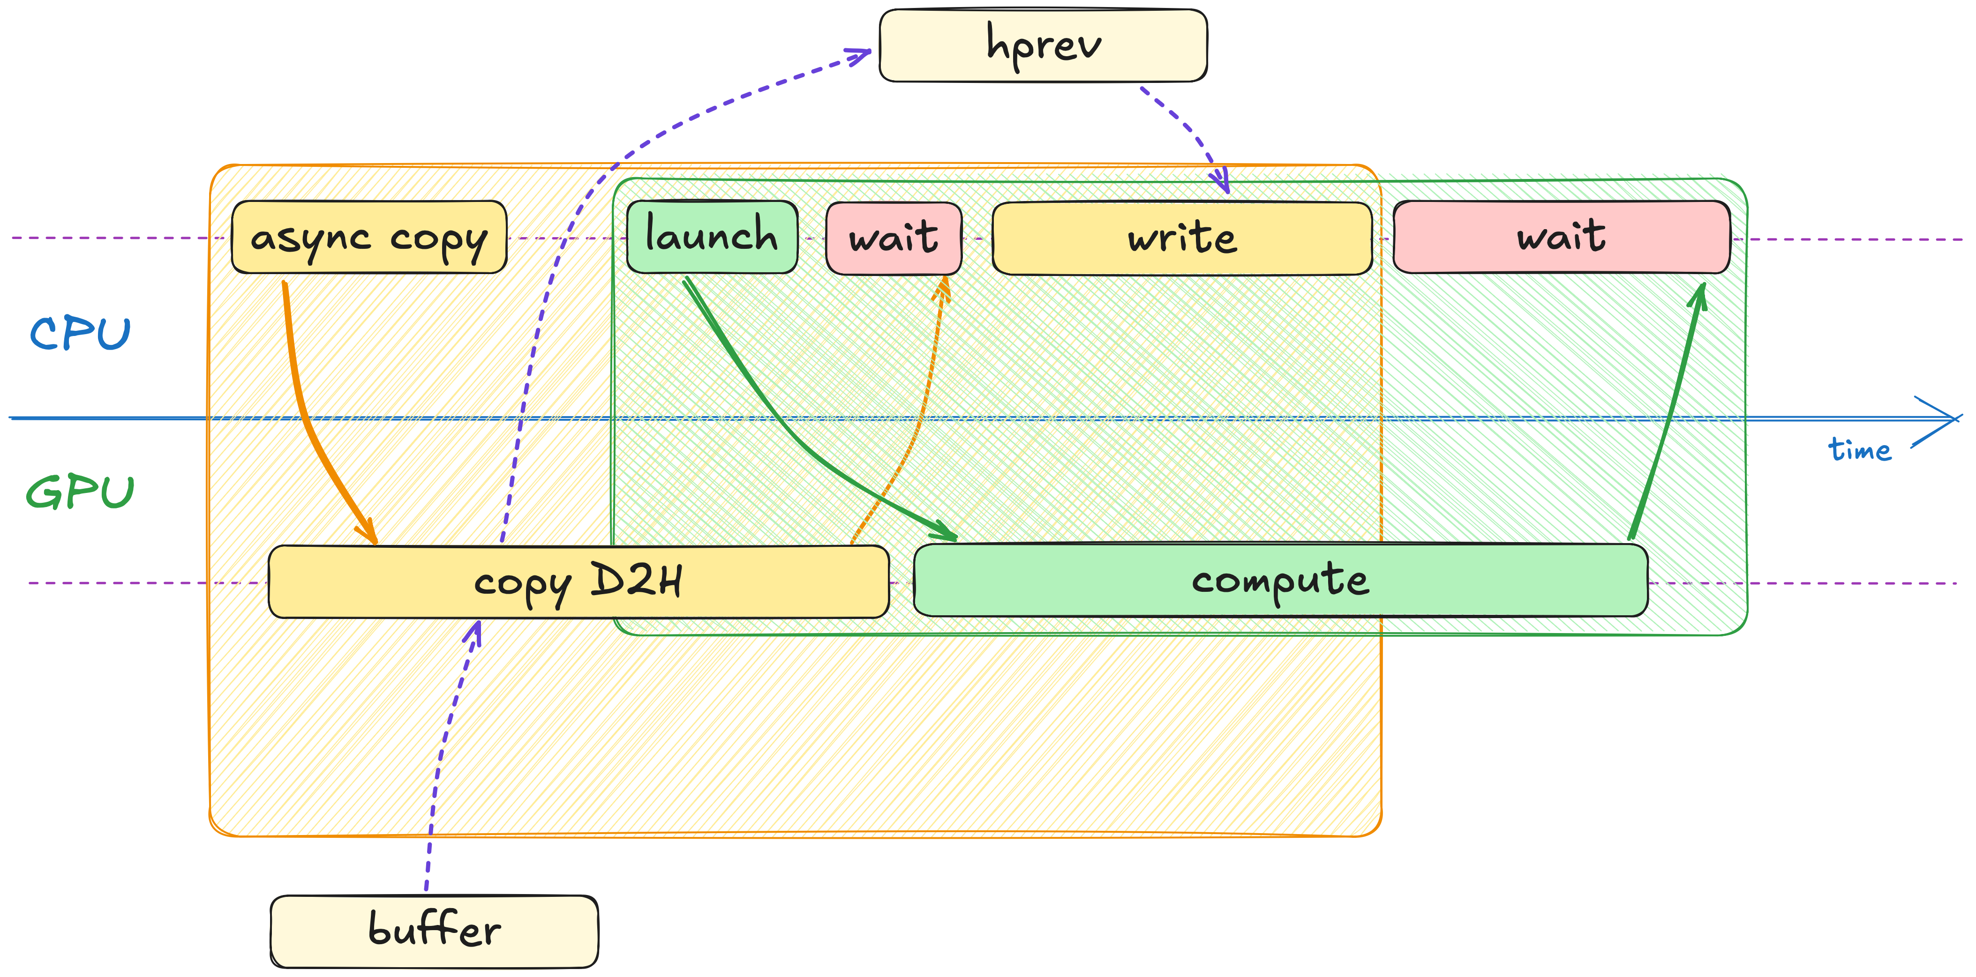
CUDA Streams
In this setup, cudaMemcpyAsync wouldn’t give us any speedup
All the submitted work is ordered on GPU
Notes:
Would simply swapping thrust::copy for cudaMemcpyAsync be enough to overlap compute with copy? Not really.
By default, all GPU operations are ordered on the GPU end.
Even though cudaMemcpyAsync is non-blocking on the CPU side, the GPU still executes it in order with everything else - just like those earlier asynchronous compute steps.
This means that GPU will wait for copy to finish before proceeding to the next compute step.

Slide 35
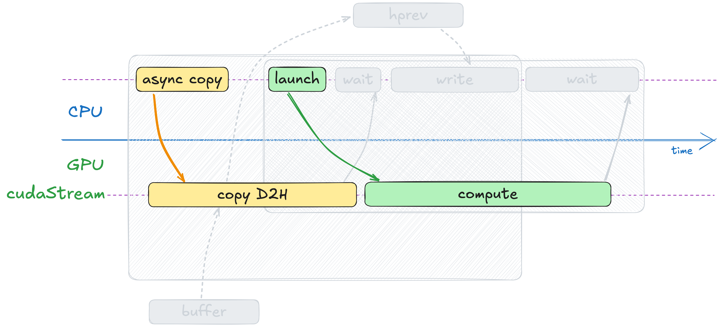
CUDA Streams
This ordering of operations on GPU is called cudaStream
When you don’t specify a stream, default one is used
Notes:
This ordering of operations on the GPU side is called a CUDA Stream.
When you don’t specify a CUDA stream, some default one is used.

Slide 36
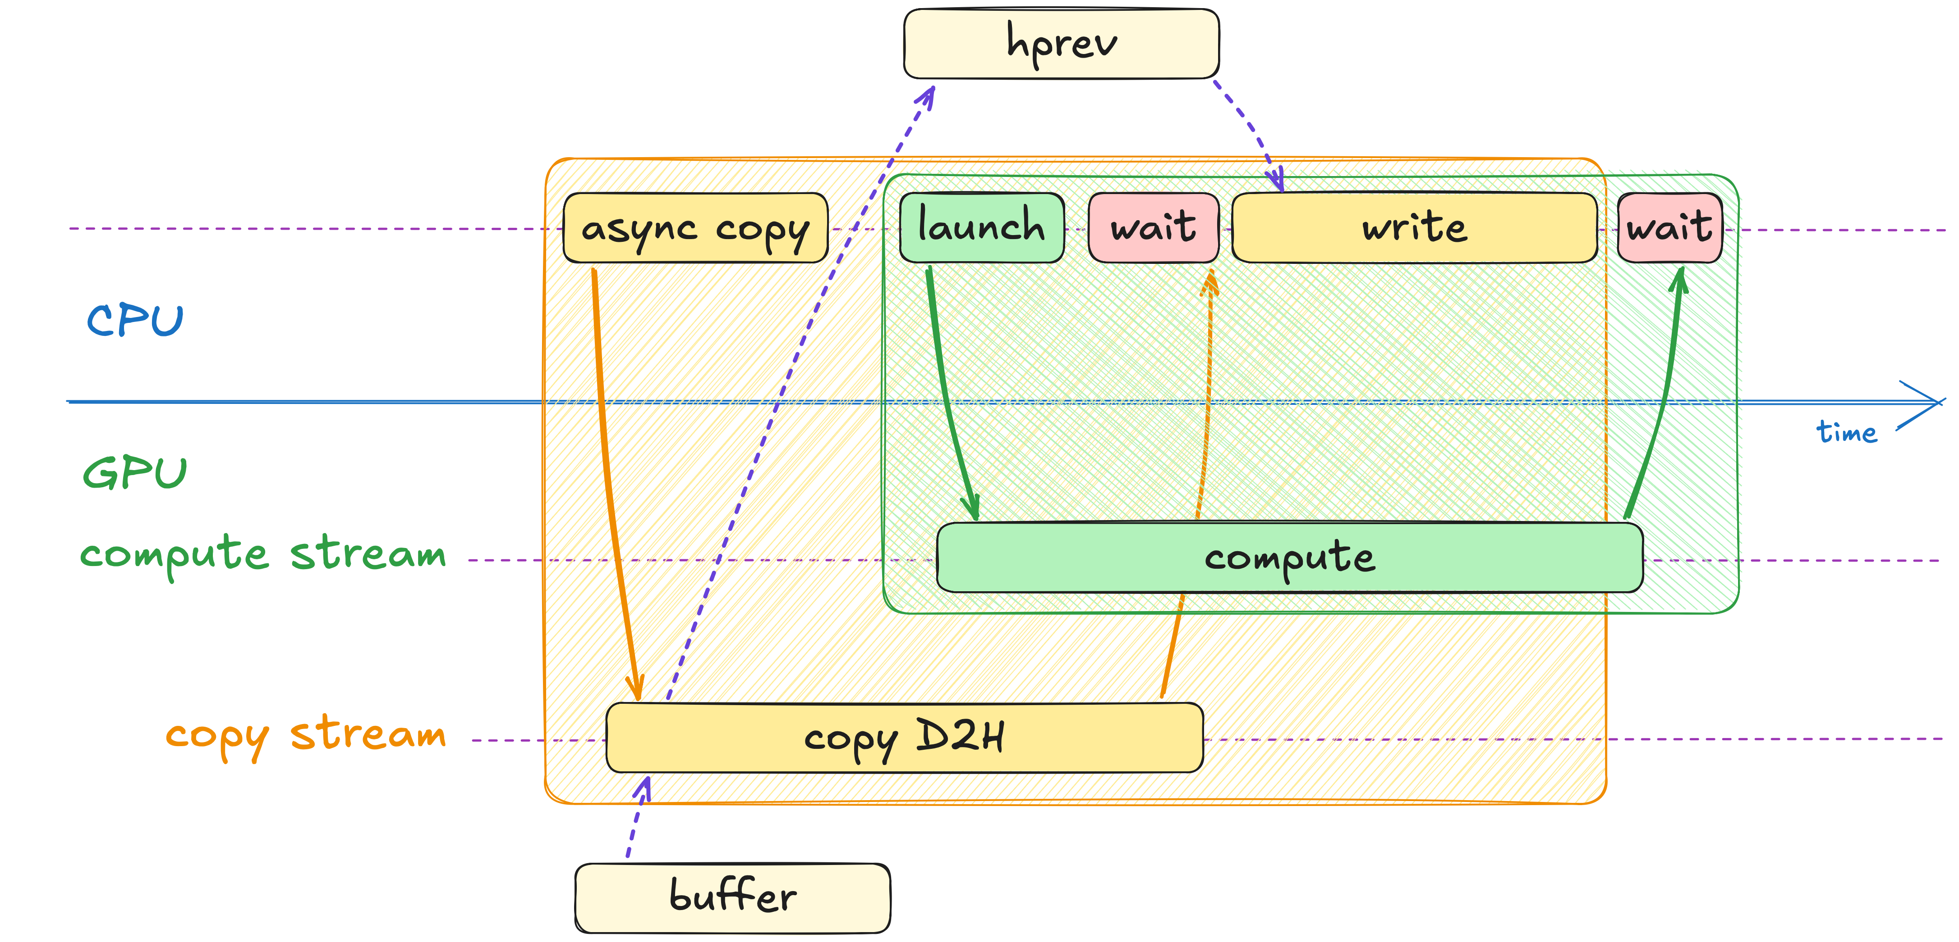
CUDA Streams
We can have more than one stream
Operations on different streams can be executed concurrently
Notes:
And the great news is that we can have as many CUDA streams as we need.
When operations run in different streams, they are no longer ordered with respect to each other and can execute concurrently.
That’s exactly what we want: if we send an asynchronous copy to one stream and our compute work to another, then those two operations can overlap.
Let’s see how that works in practice.

Slide 37
Operations on Streams
cudaStream_t copy_stream, compute_stream;
ⅠConstruction
ⅡDestruction
cudaStreamCreate(&compute_stream);
cudaStreamCreate(&copy_stream);
cudaStreamDestroy(compute_stream);
cudaStreamDestroy(copy_stream);
ⅢSynchronization
cudaStreamSynchronize(compute_stream);
cudaStreamSynchronize(copy_stream);
Waits until all preceding commands in the stream have completed
More lightweight compared to synchronizing the entire GPU
Notes:
cudaStream_t is simply a type, just like an integer.
That means we can declare our streams the same way we’d declare any other variable in C++.
In this example, we define two streams - one for memory transfers and another for computations.
However, just creating a stream variable isn’t enough; we also need to explicitly call cudaStreamCreate to initialize it.
Later, if we want to wait for the tasks in a specific stream to finish, we can use cudaStreamSynchronize, which blocks only until that particular stream’s operations are complete.
This is preferable to cudaDeviceSynchronize, which causes CPU to wait until all GPU operations have completed.
By synchronizing at the stream level, we let other streams continue to work in parallel.
Finally, once we’re done with a stream, we should call cudaStreamDestroy to release associated resources.

Slide 38
Usage of CUDA Streams
CUDA Runtime
CUB
cuBLAS
cudaError_t
cudaMemcpyAsync(
void* dst,
const void* src,
size_t count,
cudaMemcpyKind kind,
cudaStream_t stream = 0
);
cudaError_t
cub::DeviceTransform::Transform(
IteratorIn input,
IteratorOut output,
int num_items,
TransformOp op,
cudaStream_t stream = 0
);
cublasStatus_t
cublasLtMatmul(
cublasLtHandle_t lightHandle,
cublasLtMatmulDesc_t computeDesc,
const void *alpha,
const void *A,
...
cudaStream_t stream
);
Majority of asynchronous CUDA libraries accept cudaStream_t
The idea is that you’ll likely want to overlap their API with:
memory transfers,
host-side compute or IO,
or even another device-side compute!
Notes:
You’ll find cudaStream_t in almost every accelerated CUDA library.
For instance, both cudaMemcpyAsync and cub::DeviceTransform have a cudaStream_t parameter, though we haven’t had to specify it yet because it defaults to zero, which means – use the default CUDA stream.
The reason CUDA Streams is so widespread is that developers often want to overlap these library calls with other tasks.
For example, you might run device-side computations in one stream while simultaneously handling host-side I/O or memory transfers in another,

Slide 39
CUDA Streams
cudaStream_t copy_stream, compute_stream;
cudaStreamCreate(&compute_stream);
cudaStreamCreate(&copy_stream);
// ...
cudaMemcpyAsync(hprev_ptr,
dprev_ptr,
num_cells * sizeof(float),
cudaMemcpyDeviceToHost,
copy_stream);
for (int step = 0; step < steps; step++)
{
simulate(width, height, dprev, dnext, compute_stream);
dprev.swap(dnext);
}
cudaStreamSynchronize(copy_stream);
store(write_step, height, width, hprev);
cudaStreamSynchronize(compute_stream);
Create copy and compute streams
Notes:
So, let’s start by creating CUDA streams for compute and copy operations.

Slide 40
CUDA Streams
cudaStream_t copy_stream, compute_stream;
cudaStreamCreate(&compute_stream);
cudaStreamCreate(&copy_stream);
// ...
cudaMemcpyAsync(hprev_ptr,
dprev_ptr,
num_cells * sizeof(float),
cudaMemcpyDeviceToHost,
copy_stream);
for (int step = 0; step < steps; step++)
{
simulate(width, height, dprev, dnext, compute_stream);
dprev.swap(dnext);
}
cudaStreamSynchronize(copy_stream);
store(write_step, height, width, hprev);
cudaStreamSynchronize(compute_stream);
Copy device vector to host using asynchronous cudaMemcpyAsync on copy stream
Notes:
After setting up a separate copy stream, we can pass it as the last argument to cudaMemcpyAsync so that the data transfer runs in its own stream.

Slide 41
CUDA Streams
cudaStream_t copy_stream, compute_stream;
cudaStreamCreate(&compute_stream);
cudaStreamCreate(&copy_stream);
// ...
cudaMemcpyAsync(hprev_ptr,
dprev_ptr,
num_cells * sizeof(float),
cudaMemcpyDeviceToHost,
copy_stream);
for (int step = 0; step < steps; step++)
{
simulate(width, height, dprev, dnext, compute_stream);
dprev.swap(dnext);
}
cudaStreamSynchronize(copy_stream);
store(write_step, height, width, hprev);
cudaStreamSynchronize(compute_stream);
Launch CUB transform on compute stream
Notes:
Next, we can specify compute stream as the last parameter when calling cub::DeviceTransform.
By doing so, we ensure the computation runs in a different stream than the copy operation.

Slide 42
CUDA Streams
cudaStream_t copy_stream, compute_stream;
cudaStreamCreate(&compute_stream);
cudaStreamCreate(&copy_stream);
// ...
cudaMemcpyAsync(hprev_ptr,
dprev_ptr,
num_cells * sizeof(float),
cudaMemcpyDeviceToHost,
copy_stream);
for (int step = 0; step < steps; step++)
{
simulate(width, height, dprev, dnext, compute_stream);
dprev.swap(dnext);
}
cudaStreamSynchronize(copy_stream);
store(write_step, height, width, hprev);
cudaStreamSynchronize(compute_stream);
Synchronize copy stream before reading host vector
Notes:
Because the copy happens asynchronously, we have to make sure it has actually finished before reading the host data.
To do this, we call cudaStreamSynchronize on the copy stream, which blocks until operatiosn in the copy stream are complete.

Slide 43
CUDA Streams
cudaStream_t copy_stream, compute_stream;
cudaStreamCreate(&compute_stream);
cudaStreamCreate(&copy_stream);
// ...
cudaMemcpyAsync(hprev_ptr,
dprev_ptr,
num_cells * sizeof(float),
cudaMemcpyDeviceToHost,
copy_stream);
for (int step = 0; step < steps; step++)
{
simulate(width, height, dprev, dnext, compute_stream);
dprev.swap(dnext);
}
cudaStreamSynchronize(copy_stream);
store(write_step, height, width, hprev);
cudaStreamSynchronize(compute_stream);
Synchronize compute stream before starting the next step
Notes:
After we’re done writing the results to disk, we synchronize with the compute stream to confirm that the GPU computations have also finished.
In the end, our approach looks like the diagram on the slide: we perform two asynchronous operations - one for copying data, one for computing - in separate streams.
We also include two synchronization points to ensure everything finishes in the right order.

Slide 44
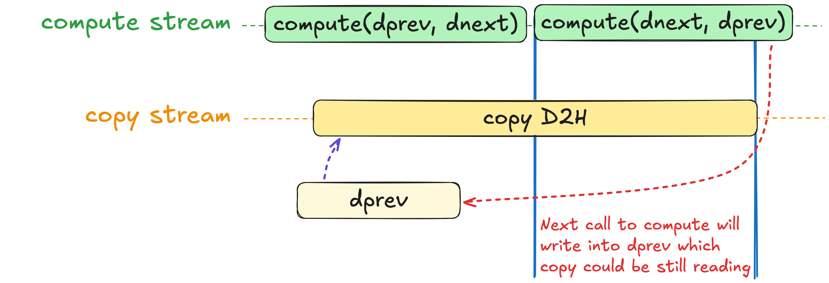
CUDA Streams
cudaStream_t copy_stream, compute_stream;
cudaStreamCreate(&compute_stream);
cudaStreamCreate(&copy_stream);
// ...
cudaMemcpyAsync(hprev_ptr,
dprev_ptr,
num_cells * sizeof(float),
cudaMemcpyDeviceToHost,
copy_stream);
for (int step = 0; step < steps; step++)
{
simulate(width, height, dprev, dnext, compute_stream);
dprev.swap(dnext);
}
cudaStreamSynchronize(copy_stream);
store(write_step, height, width, hprev);
cudaStreamSynchronize(compute_stream);
⚠
This code has a data race!
Different streams execute their operations out of order
Notes:
And… congratulations, we’ve just introduced our first data race!
Let’s walk through the first few iterations to see why:
1. We issue a copy from dprev to the host.
2. The first compute iteration reads from dprev and writes into dnext, which is fine.
3. But the next iteration reads from dnext and writes back into dprev.
Because these operations run in different streams, the GPU can interleave them in unexpected ways.
This means that while data is still being copied from dprev to the host, it might get overwritten by the next compute iteration in another stream.
If we want correct visualization results, we’ll have to fix this.

Slide 45
CUDA Streams
thrust::copy(d_prev.begin(), d_prev.end(), d_buffer.begin());
cudaMemcpyAsync(htemp_ptr, dbuffer_ptr, num_bytes, cudaMemcpyDeviceToHost, copy_stream);
for (int step = 0; step < steps; step++)
{
simulate(width, height, dprev, dnext, compute_stream);
dprev.swap(dnext);
}
Most problems can be solved with another level of indirection
Let’s:
Allocate a device buffer
Copy dprev into it in compute stream
Start asynchronous copy from this buffer to hprev
Notes:
Like many computer science problems, we can solve this by adding another layer of indirection.
We can allocate an extra device buffer, copy data into it synchronously, and then copy from that staging buffer to CPU.
Since no one else is writing to the staging buffer, there’s no risk of a data race.
But doesn’t that defeat the purpose of overlapping compute with transfers?
At the first glance, it may seem so.

Slide 46
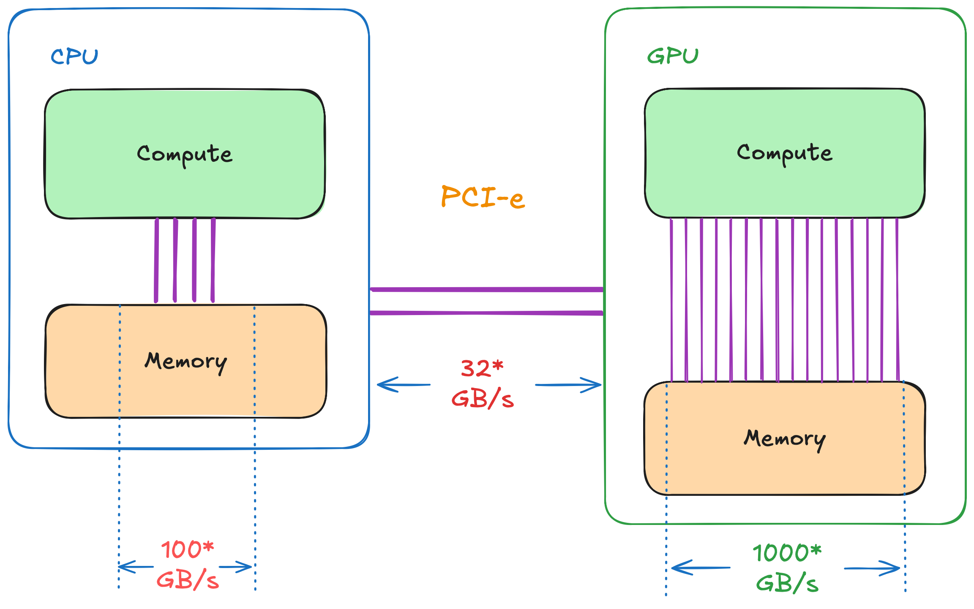
Evaluating D2D Copy Overhead
Notes:
But if you take a closer look at the bandwidth across your entire system, this approach makes a lot more sense.
Copying data within GPU memory can hit speeds of around a thousand gigabytes per second.
Moving data within CPU memory is somewhat slower, on the order of a hundred gigabytes per second.
However, transfers between the CPU and GPU often go through the PCIe bus, which might provide as little as 32 gigabytes per second.
That means that the real bottleneck is cross-memory transfers between the CPU and GPU.
The device-to-device copy is going to be so fast it’s practically ‘free’ compared to the cost of sending data over PCIe.
So, it still makes sense to overlap the slower device-to-host copy with ongoing GPU computations.

Slide 47
Exercise: Overlap Compute and Copy
15 minutes
Use cudaMemcpyAsync instead of thrust::copy
Put compute and async copy on different streams
Profile resulting code with Nsight Systems
02.03-Streams/02.03.02-Exercise-Async-Copy.ipynb
Notes:
That brings us to our next exercise.
In this task, you’ll replace thrust::copy with cudaMemcpyAsync to make your device-to-host transfer asynchronous.
You’ll also place your compute and copy operations on separate streams and synchronize them exactly as shown in the diagram on the slide.
Finally, once you’re comfortable with your changes, you’ll profile the code in Nsight Systems to see if it behaves as expected.
For this, you’ll have 15 minutes starting now.

Slide 48
Exercise: Overlap Compute and Copy
Solution
cudaStream_t copy_stream, compute_stream;
cudaStreamCreate(&compute_stream);
cudaStreamCreate(&copy_stream);
thrust::host_vector<float> hprev(height * width);
thrust::copy(d_prev.begin(), d_prev.end(), d_buffer.begin());
cudaMemcpyAsync(thrust::raw_pointer_cast(htemp.data()),
thrust::raw_pointer_cast(dbuffer.data()),
num_cells * sizeof(float), cudaMemcpyDeviceToHost,
copy_stream);
for (int compute_step = 0; compute_step < compute_steps; compute_step++)
{
simulate(width, height, dprev, dnext, compute_stream);
dprev.swap(dnext);
}
cudaStreamSynchronize(copy_stream);
store(write_step, height, width, hprev);
cudaStreamSynchronize(compute_stream);
Create compute and copy streams
Notes:
Time’s up!
Let’s walk through the solution.
The first step is to create two CUDA streams - compute-stream for GPU computations and copy-stream for data transfers.
We do this by declaring two cudaStream_t variables and calling cudaStreamCreate on them.

Slide 49
Exercise: Overlap Compute and Copy
Solution
cudaStream_t copy_stream, compute_stream;
cudaStreamCreate(&compute_stream);
cudaStreamCreate(&copy_stream);
thrust::host_vector<float> hprev(height * width);
thrust::copy(d_prev.begin(), d_prev.end(), d_buffer.begin());
cudaMemcpyAsync(thrust::raw_pointer_cast(htemp.data()),
thrust::raw_pointer_cast(dbuffer.data()),
num_cells * sizeof(float), cudaMemcpyDeviceToHost,
copy_stream);
for (int compute_step = 0; compute_step < compute_steps; compute_step++)
{
simulate(width, height, dprev, dnext, compute_stream);
dprev.swap(dnext);
}
cudaStreamSynchronize(copy_stream);
store(write_step, height, width, hprev);
cudaStreamSynchronize(compute_stream);
Synchronously copy into the staging buffer
Notes:
Next, we perform a device-to-device copy from our previous temperatures into a staging buffer.
We can still use thrust::copy here, because device-to-device copies are generally very.
This step ensures our device data we copy to host remains untouched by subsequent computations, preventing any data races.

Slide 50
Exercise: Overlap Compute and Copy
Solution
cudaStream_t copy_stream, compute_stream;
cudaStreamCreate(&compute_stream);
cudaStreamCreate(&copy_stream);
thrust::host_vector<float> hprev(height * width);
thrust::copy(d_prev.begin(), d_prev.end(), d_buffer.begin());
cudaMemcpyAsync(thrust::raw_pointer_cast(htemp.data()),
thrust::raw_pointer_cast(dbuffer.data()),
num_cells * sizeof(float), cudaMemcpyDeviceToHost,
copy_stream);
for (int compute_step = 0; compute_step < compute_steps; compute_step++)
{
simulate(width, height, dprev, dnext, compute_stream);
dprev.swap(dnext);
}
cudaStreamSynchronize(copy_stream);
store(write_step, height, width, hprev);
cudaStreamSynchronize(compute_stream);
Asynchronously copy from staging buffer into host vector in the copy stream
Notes:
After that, we invoke the asynchronous copy on the copy stream by calling cudaMemcpyAsync.
Since cudaMemcpyAsync operates on raw pointers, we use thrust::raw_pointer_cast to retrieve the underlying pointers from Thrust containers.

Slide 51
Exercise: Overlap Compute and Copy
Solution
cudaStream_t copy_stream, compute_stream;
cudaStreamCreate(&compute_stream);
cudaStreamCreate(&copy_stream);
thrust::host_vector<float> hprev(height * width);
thrust::copy(d_prev.begin(), d_prev.end(), d_buffer.begin());
cudaMemcpyAsync(thrust::raw_pointer_cast(htemp.data()),
thrust::raw_pointer_cast(dbuffer.data()),
num_cells * sizeof(float), cudaMemcpyDeviceToHost,
copy_stream);
for (int compute_step = 0; compute_step < compute_steps; compute_step++)
{
simulate(width, height, dprev, dnext, compute_stream);
dprev.swap(dnext);
}
cudaStreamSynchronize(copy_stream);
store(write_step, height, width, hprev);
cudaStreamSynchronize(compute_stream);
Launch compute on compute stream
Notes:
Finally, we update the CUB transform call to run on the compute stream we created earlier.
By specifying the stream as the last parameter, we’re telling CUB to execute this transformation independently of any operations on other streams.

Slide 52
Exercise: Overlap Compute and Copy
Solution
cudaStream_t copy_stream, compute_stream;
cudaStreamCreate(&compute_stream);
cudaStreamCreate(&copy_stream);
thrust::host_vector<float> hprev(height * width);
thrust::copy(d_prev.begin(), d_prev.end(), d_buffer.begin());
cudaMemcpyAsync(thrust::raw_pointer_cast(htemp.data()),
thrust::raw_pointer_cast(dbuffer.data()),
num_cells * sizeof(float), cudaMemcpyDeviceToHost,
copy_stream);
for (int compute_step = 0; compute_step < compute_steps; compute_step++)
{
simulate(width, height, dprev, dnext, compute_stream);
dprev.swap(dnext);
}
cudaStreamSynchronize(copy_stream);
store(write_step, height, width, hprev);
cudaStreamSynchronize(compute_stream);
Wait for copy on the copy stream to finish before reading the data
Notes:
After launching all the asynchronous operations, we call cudaStreamSynchronize on the copy stream to make sure the data transfer to the host has finished.
Only once this function returns do we know that the host data is safe to read.
At that point, we can proceed to writing the updated host data to disk.

Slide 53
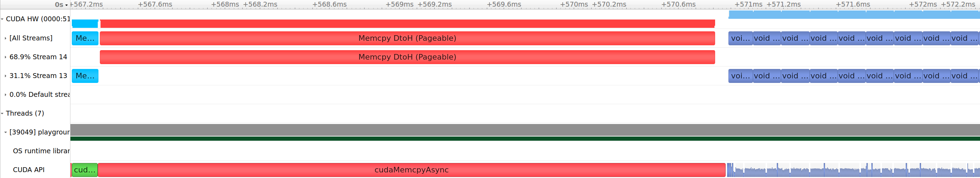
CUDA Streams
D2D
D2H
GPU
CPU
D2D copy is close to no overhead compared to D2H
Regardless, there’s something wrong with the profile
Transformation doesn’t start before copy finishes
Notes:
After looking at the Nsight profile, we have both good news and bad news.
The good news is that our intuition about the cost of data transfers was correct!
The device-to-device copy on the left is significantly faster than the device-to-host copy in the middle.
This confirms that the PCIe transfer is the real bottleneck.
The bad news is that, despite using separate streams, compute is still waiting for the copy to finish.
That seems puzzling - didn’t we just separate them into different streams to avoid this serialization?
It turns out this isn’t entirely bad news.
It means that there’s more to learn about how the GPU hardware works.

Slide 54
Virtual Memory at a Glance
Virtual memory consists of pages
Any page can end up on disk, unless it was locked or pinned
Notes:
To understand why our copy and compute operations didn’t overlap, we need to look at how memory actually works.
Your program uses virtual memory, which is divided into pages.
Most of the time, these pages are backed by physical RAM, but if RAM is short on space, the operating system can swap pages out to disk.
As a result, at any given moment, you can’t be entirely certain whether a particular page is in RAM or on disk.
To make sure a page remains in physical memory, we can ‘page-lock’ or ‘pin’ it.
By pinning pages, we tell the operating system it’s not allowed to move them to disk.

Slide 55
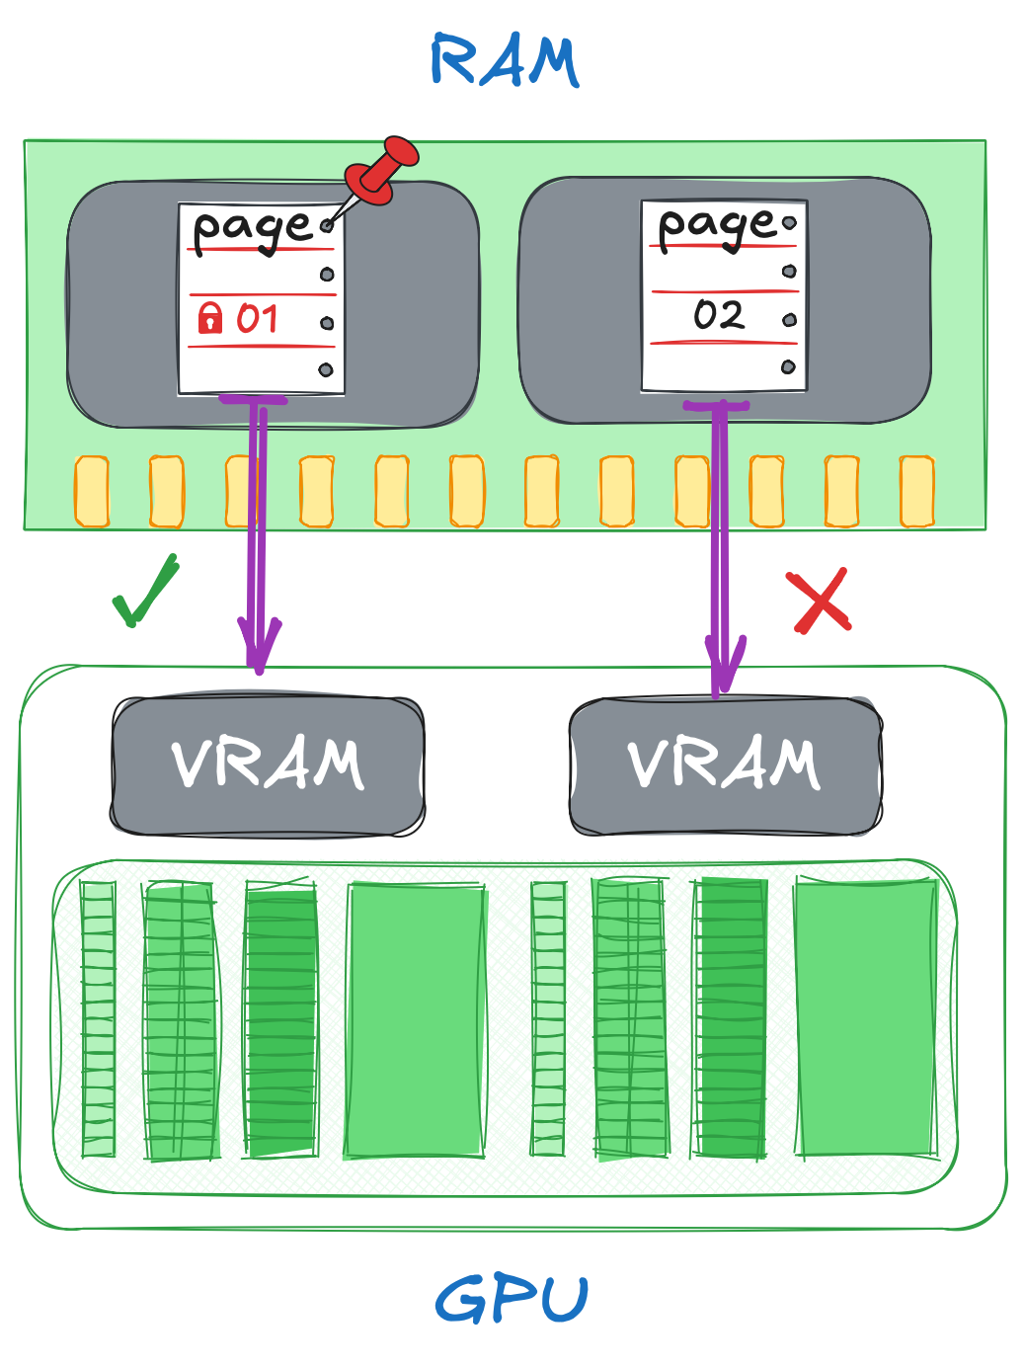
Virtual Memory at a Glance
GPU can only read from pinned memory!
But then, how does cudaMemcpyAsync work?
Notes:
So how does this relate to GPUs?
As it turns out, a GPU can only read from pinned (page-locked) memory.
That raises a question, though: we haven’t done anything special when transferring data between the CPU and GPU.
So, how did it work up until now?

Slide 56
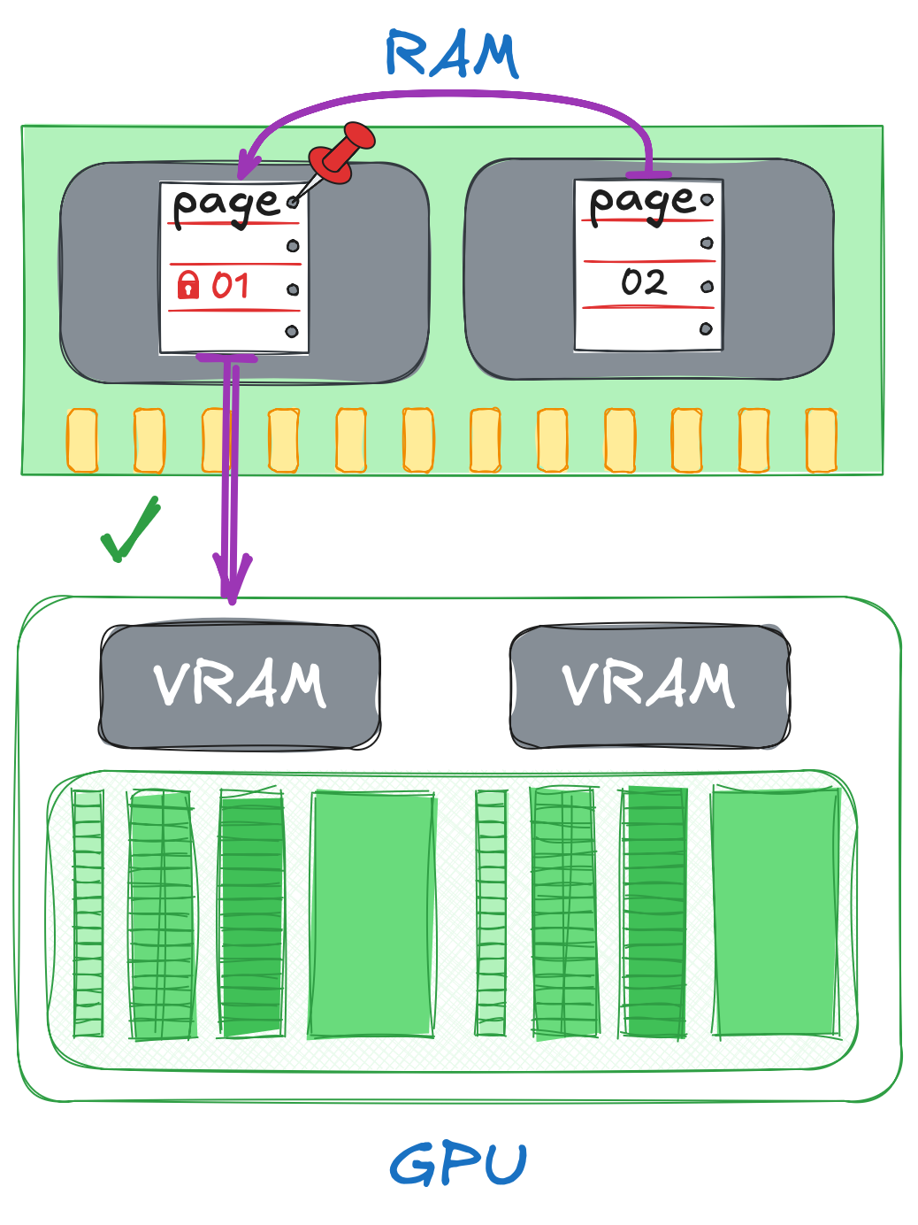
Virtual Memory at a Glance
Transfers from pageable memory work through a staging buffer in pinned memory
Hence, transfers from pageable memory take longer and hinders asynchrony
Fortunately, we can use pinned memory with thrust::universal_host_pinned_vector
Notes:
Behind the scenes, the CUDA runtime uses a small pinned buffer as a staging area for transfers.
When we copy data from regular (pageable) memory, the driver moves a chunk of data into this staging buffer, sends that chunk to the GPU, waits for it to finish, and then repeats.
This process effectively makes the copy synchronous, blocking any chance to overlap with computation.
The good news is we can avoid this by allocating pinned memory ourselves.
In Thrust, this is as simple as using a universal host pinned vector instead of a regular host vector.
By doing so, we bypass the hidden staging step and enable truly asynchronous transfers that can overlap with our GPU workloads.

Slide 57
Exercise: Use Pinned Memory
5 minutes
Use thrust::universal_host_pinned_vector to allocate host vector in pinned memory
Profile your application after the change
Locate device-to-host copy and identify if it is being overlapped with compute
02.04-Pinned-Memory/02.04.02-Exercise-Copy-Overlap.ipynb
Notes:
[optional – if time permits]
Which brings us to the final exercise in this section.
This time, you’ll allocate pinned memory by using a universal host pinned vector instead of a regular host vector.
After making that change, run your application under Nsight Systems again and look for the device-to-host copy in the timeline.
See if it now overlaps with compute.
For this, you have 5 minutes starting now.

Slide 58
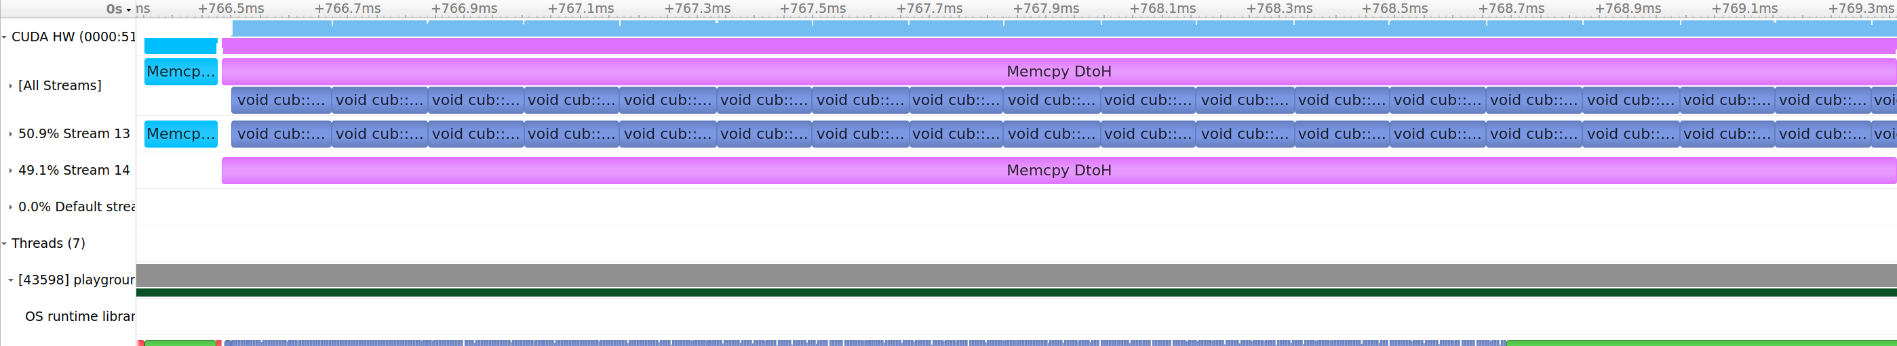
Exercise: Use Pinned Memory
Solution
cudaStream_t copy_stream, compute_stream;
cudaStreamCreate(&compute_stream);
cudaStreamCreate(&copy_stream);
thrust::universal_host_pinned_vector<float> hprev(height * width);
cudaMemcpy(thrust::raw_pointer_cast(dbuffer.data()),
thrust::raw_pointer_cast(dprev.data()),
num_cells * sizeof(float), cudaMemcpyDeviceToDevice);
...
Notes:
The change is pretty straightforward - just switch your host vector to the universal host pinned vector.
With that done, the device-to-host transfer now overlaps compute.
As the profiling timeline shows, GPU can perform many compute steps while data is being copied.
Which further improves efficiency of our program.

Slide 59
Takeaways
Prefer asynchronous programming model:
to overlap memory transfers
to overlap CPU and GPU computation
or even different GPU computations
Notes:
Let’s quickly go over some key takeaways.
Prefer asynchronous programming model to overlap memory transfers, CPU tasks, and GPU computations.

Slide 60
Takeaways
Prefer asynchronous programming model:
to overlap memory transfers
to overlap CPU and GPU computation
or even different GPU computations
Use CUB for
asynchronous general-purpose parallel algorithms
CUB
auto begin = std::chrono::high_resolution_clock::now();
auto cell_ids = thrust::make_counting_iterator(0);
cub::DeviceTransform::Transform(
cell_ids, out.begin(), num_cells, compute);
auto end = std::chrono::high_resolution_clock::now();
Notes:
Use CUB for general-purpose asynchronous parallel algorithms

Slide 61
Takeaways
Prefer asynchronous programming model:
to overlap memory transfers
to overlap CPU and GPU computation
or even different GPU computations
Use CUB for
asynchronous general-purpose parallel algorithms
Use NVIDIA Nsight Systems:
to profile your code
identify opportunities for optimization
visualize asynchronous execution
use NVTX to simplify profiling
Notes:
Use Nsight to profile your code, identify opportunities for optimization, and visualize asynchronous execution.
To further simplify profiling with Nsight, use NVTX ranges.

Slide 62
Takeaways
Prefer asynchronous programming model:
to overlap memory transfers
to overlap CPU and GPU computation
or even different GPU computations
Use CUB for
asynchronous general-purpose parallel algorithms
Use NVIDIA Nsight Systems:
to profile your code
identify opportunities for optimization
visualize asynchronous execution
use NVTX to simplify profiling
Use cudaStream_t:
to enable asynchronous execution with CPU and other streams
Notes:
Use CUDA streams to enable asynchronous execution with CPU and other streams

Slide 63
Takeaways
Prefer asynchronous programming model:
to overlap memory transfers
to overlap CPU and GPU computation
or even different GPU computations
Use CUB for
asynchronous general-purpose parallel algorithms
Use NVIDIA Nsight Systems:
to profile your code
identify opportunities for optimization
visualize asynchronous execution
use NVTX to simplify profiling
Use cudaStream_t:
to enable asynchronous execution with CPU and other streams
Use cudaMemcpyAsync:
to make memory copies asynchronous with respect to CPU
cudaError_t cudaMemcpyAsync(
void* dst,
const void* src,
size_t count,
cudaMemcpyKind kind
);
Destination memory address
Source memory address
Size in bytes to copy
cudaMemcpyHostToHost
...
Notes:
Use cudaMemcpyAsync to make copies asynchronous with respect to CPU

Slide 64
Takeaways
Prefer asynchronous programming model:
to overlap memory transfers
to overlap CPU and GPU computation
or even different GPU computations
Use CUB for
asynchronous general-purpose parallel algorithms
Use NVIDIA Nsight Systems:
to profile your code
identify opportunities for optimization
visualize asynchronous execution
use NVTX to simplify profiling
Use cudaStream_t:
to enable asynchronous execution with CPU and other streams
Use cudaMemcpyAsync:
to make memory copies asynchronous with respect to CPU
Use pinned memory to:
to make copy from and to device asynchronous
make copy from and to device faster
Notes:
Finally, use pinned memory for asynchronous data transfers and improved performance

Slide 65
Break
10 minutes
Notes:
Let’s take a short break.
We’ll continue in 15 minutes.

